Slide 1

Microsoft 365 In-Person Training
(Microsoft Planner & Teams)
Welcome back! Thank you for your time today for the second and final in-person session of your Microsoft 365 Optimization Training.
Please find the assigned seat with your name. Then, log into the provided laptop with the instructions emailed to you prior to this session. If you have any issues logging in, please reach out to one of the Business Applications team members leading this session for assistance.
Additionally, if you haven’t already done so, please download the Teams mobile app on a mobile device (such as your phone). If you have any issues downloading the Teams mobile app, please reach out for assistance.

Slide 2
Training Agenda
  Pre-Survey
  Module 1
  Break
  Module 2
  Break
  Module 3
  Break
  Module 4
  Optional Q&A and One-on-One Support
Notes:
trainers elaborate on the purpose of each agenda item

Slide 3
Survey Instructions for Poll Everywhere
1. Open the Poll Everywhere link from the email that was sent to you prior to this session (PollEv.com/staffdevelopment624)
2. Click “Start survey”
3. Answer all the questions honestly and to the best of your ability. Remember that all answers are anonymous!
4. When you have answered all of the questions, click “Submit survey” at the bottom of the page

Slide 4
Module 1
In-Depth Review of Planner (My Tasks)
By the end of Module 1, you will be able to demonstrate how to:
  Open Planner in Teams
  Open My Tasks in Planner
  Locate task details and edit these details
  Open task cards
  Create recurring tasks
Notes:
maybe contextualize with some examples of recurring tasks

Slide 5
(Q1)
Where do you click to open Planner?

Slide 6
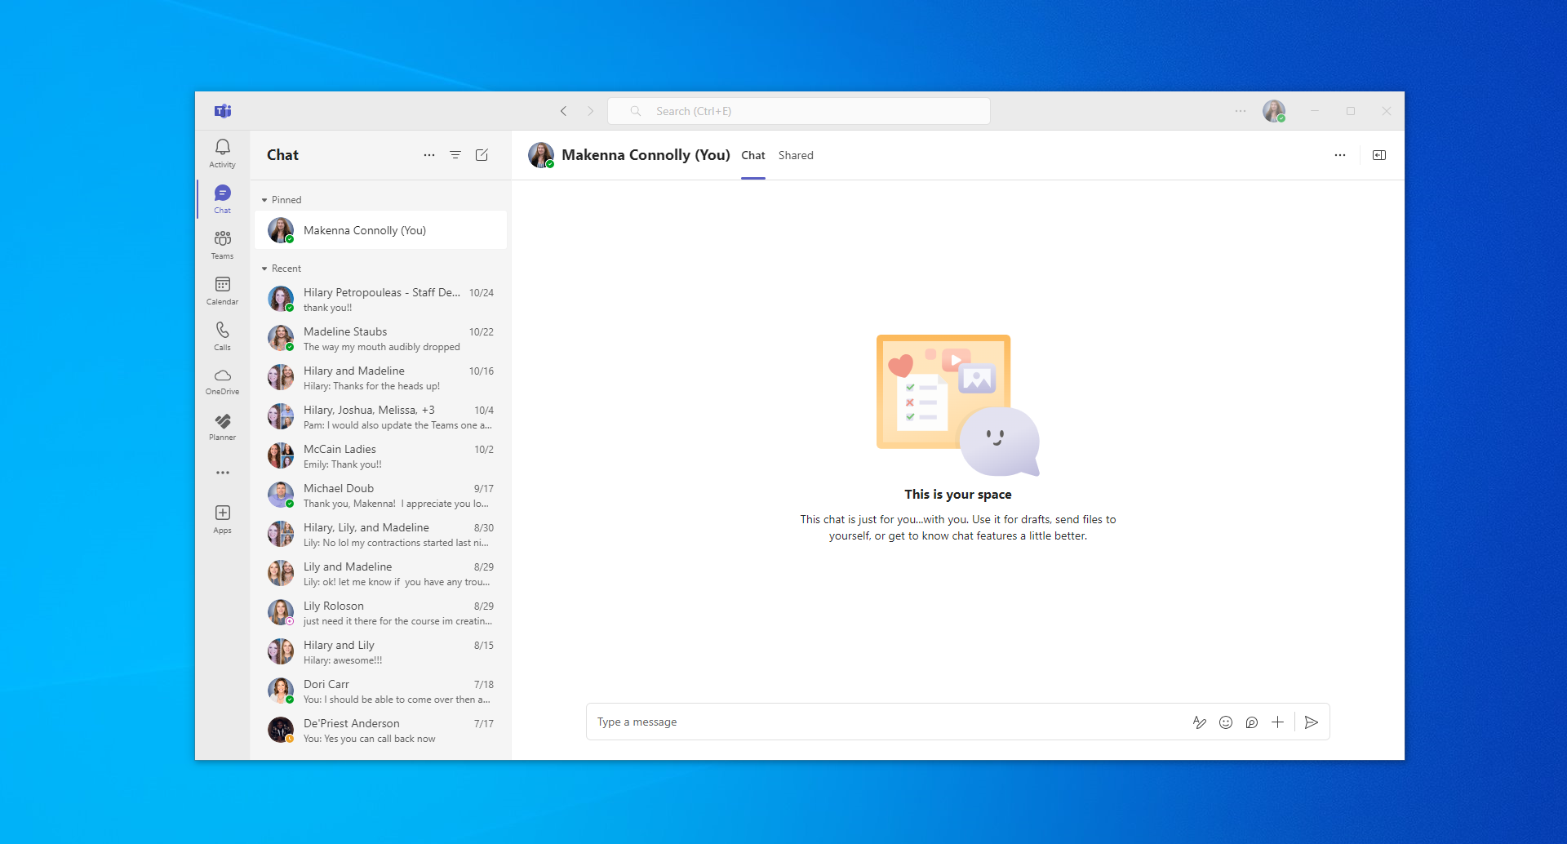


Slide 7
(Q2)
Where in Planner do you click to open My Tasks?

Slide 8
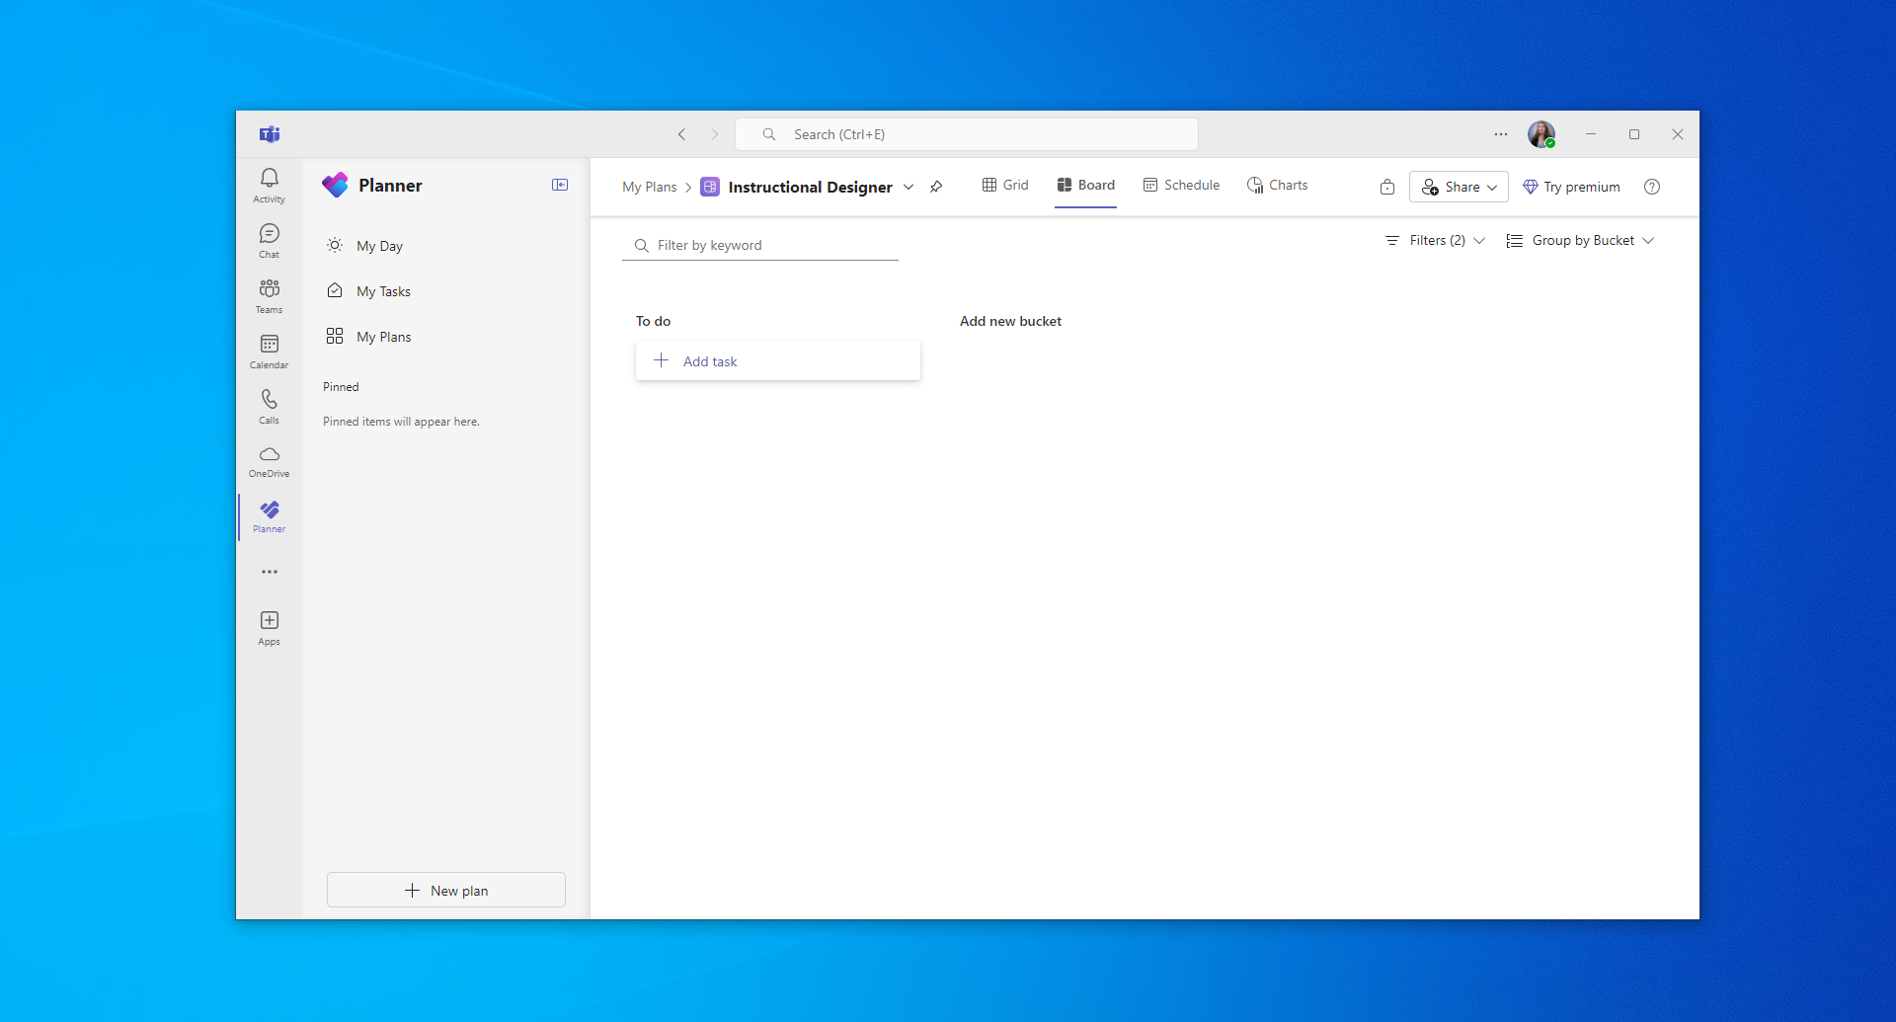

Slide 9
(Q3)
Click an area of My Tasks that displays any type of information about the task.
Notes:
have learners click whatever information stands out to them/autonomy

Slide 10
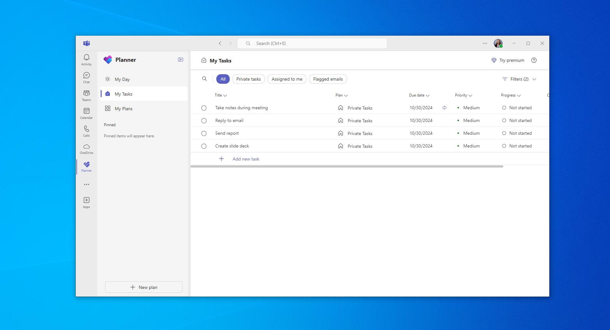

Slide 11
(Q4)
After hovering your cursor over a task title and clicking the three dots, where do you click on the options menu to open a task card?

Slide 12
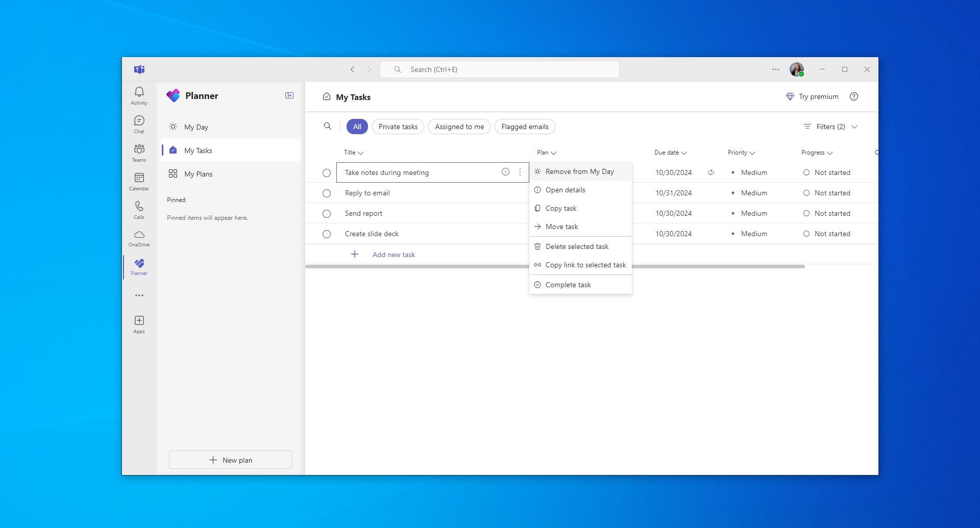

Slide 13
(Q5)
After opening a task card, where do you click to create a recurring task?

Slide 14
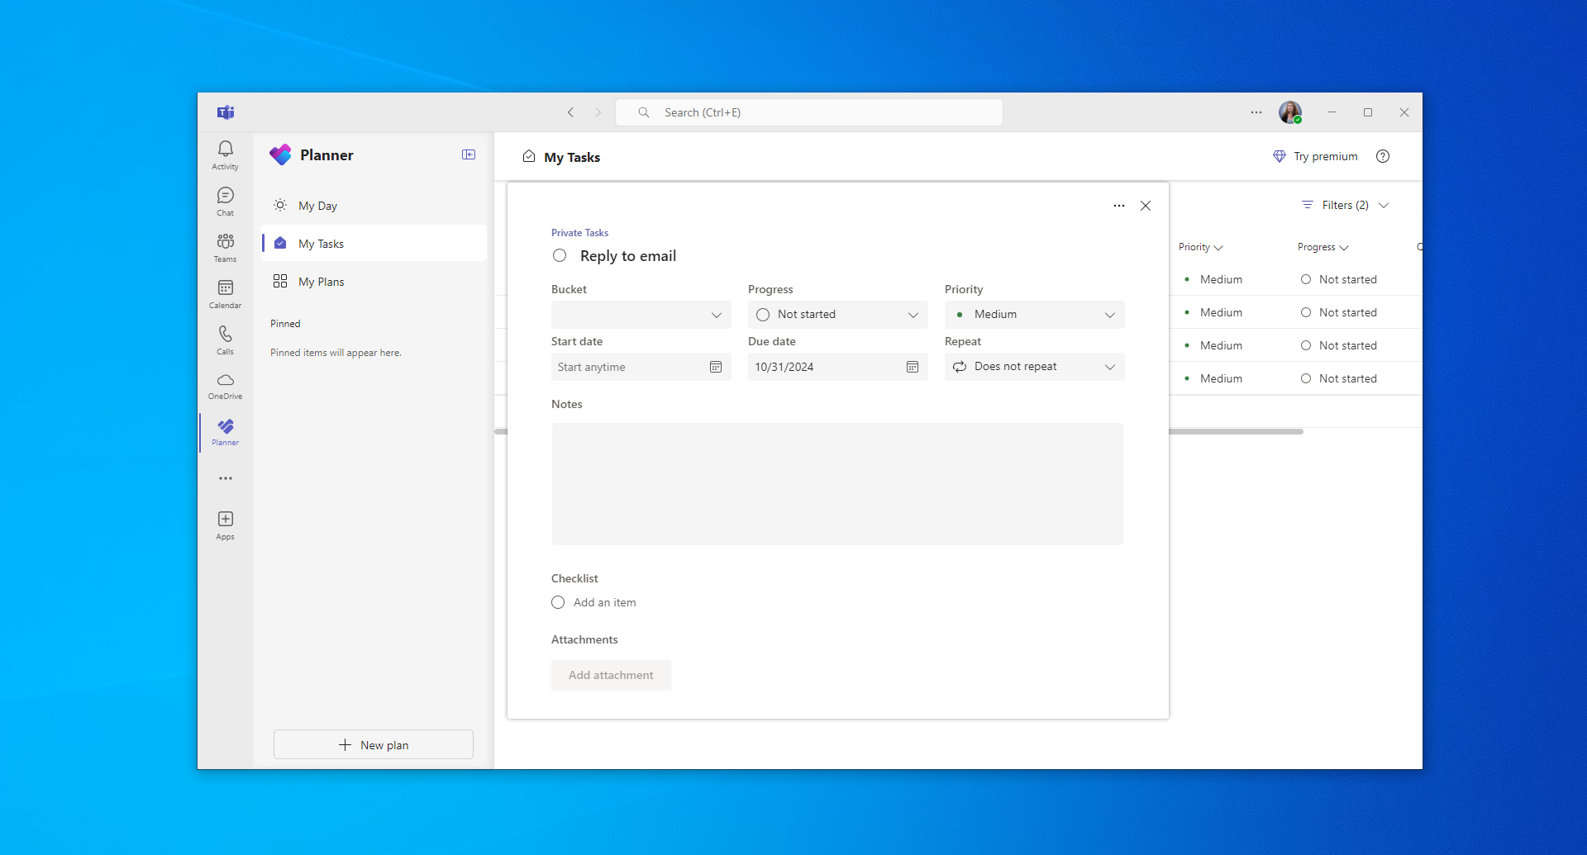

Slide 15
Break Time!
Please plan to be back 10 minutes after the start of our break.

Slide 16
Module 2
In-Depth Review of Planner (My Plans & My Day)
By the end of Module 2, you will be able to demonstrate how to:
  Open My Plans in Planner
  Create a plan in My Plans
  Create buckets within a plan
  Assign tasks through a plan
  Open My Day in Planner

Slide 17
(Q1)
Where in Planner do you click to open My Plans?

Slide 18


Slide 19
(Q2)
Where in My Plans do you click to create a new plan?

Slide 20
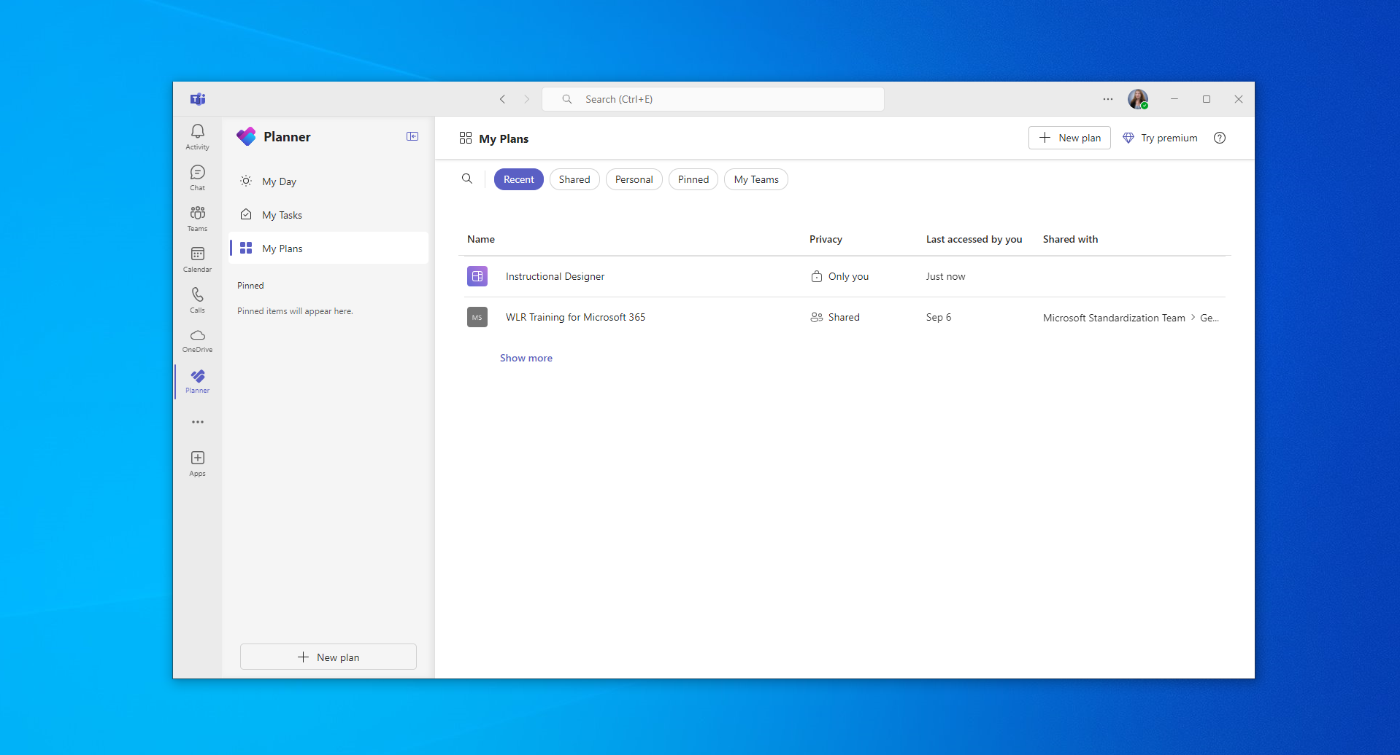

Slide 21
(Q3)
After opening a specific plan, where do you click to create a bucket for tasks?

Slide 22
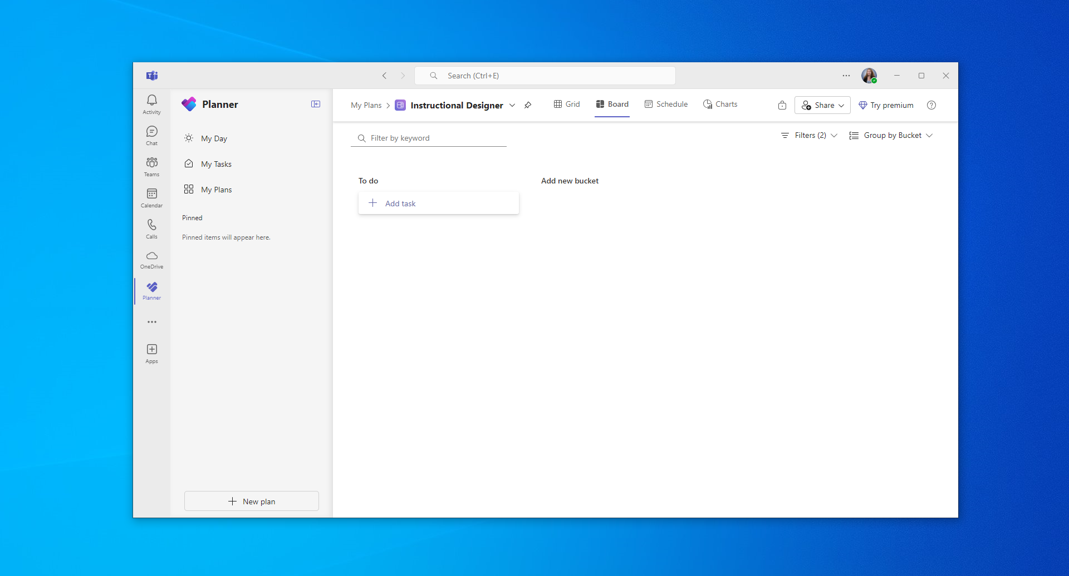

Slide 23
(Q4)
After clicking “+ Add task” within a plan, where do you click to assign a task?

Slide 24
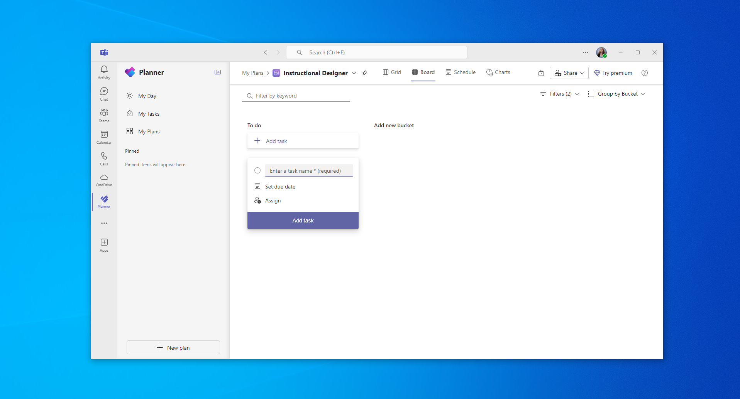

Slide 25
(Q5)
Where in Planner do you click to open My Day?

Slide 27
Break Time!
Please plan to be back 10 minutes after the start of our break.

Slide 28
Module 3
Review of Calendar Tab, Teams Tab, & Chat Tab
By the end of Module 3, you will be able to demonstrate how to:
  Open your calendar in Teams
  Schedule a meeting through your Teams calendar
  Customize the settings of a meeting
  Access posts for any channels within a team

Slide 29
(Q1)
After opening the Calendar tab, where do you click to schedule a new meeting?

Slide 30
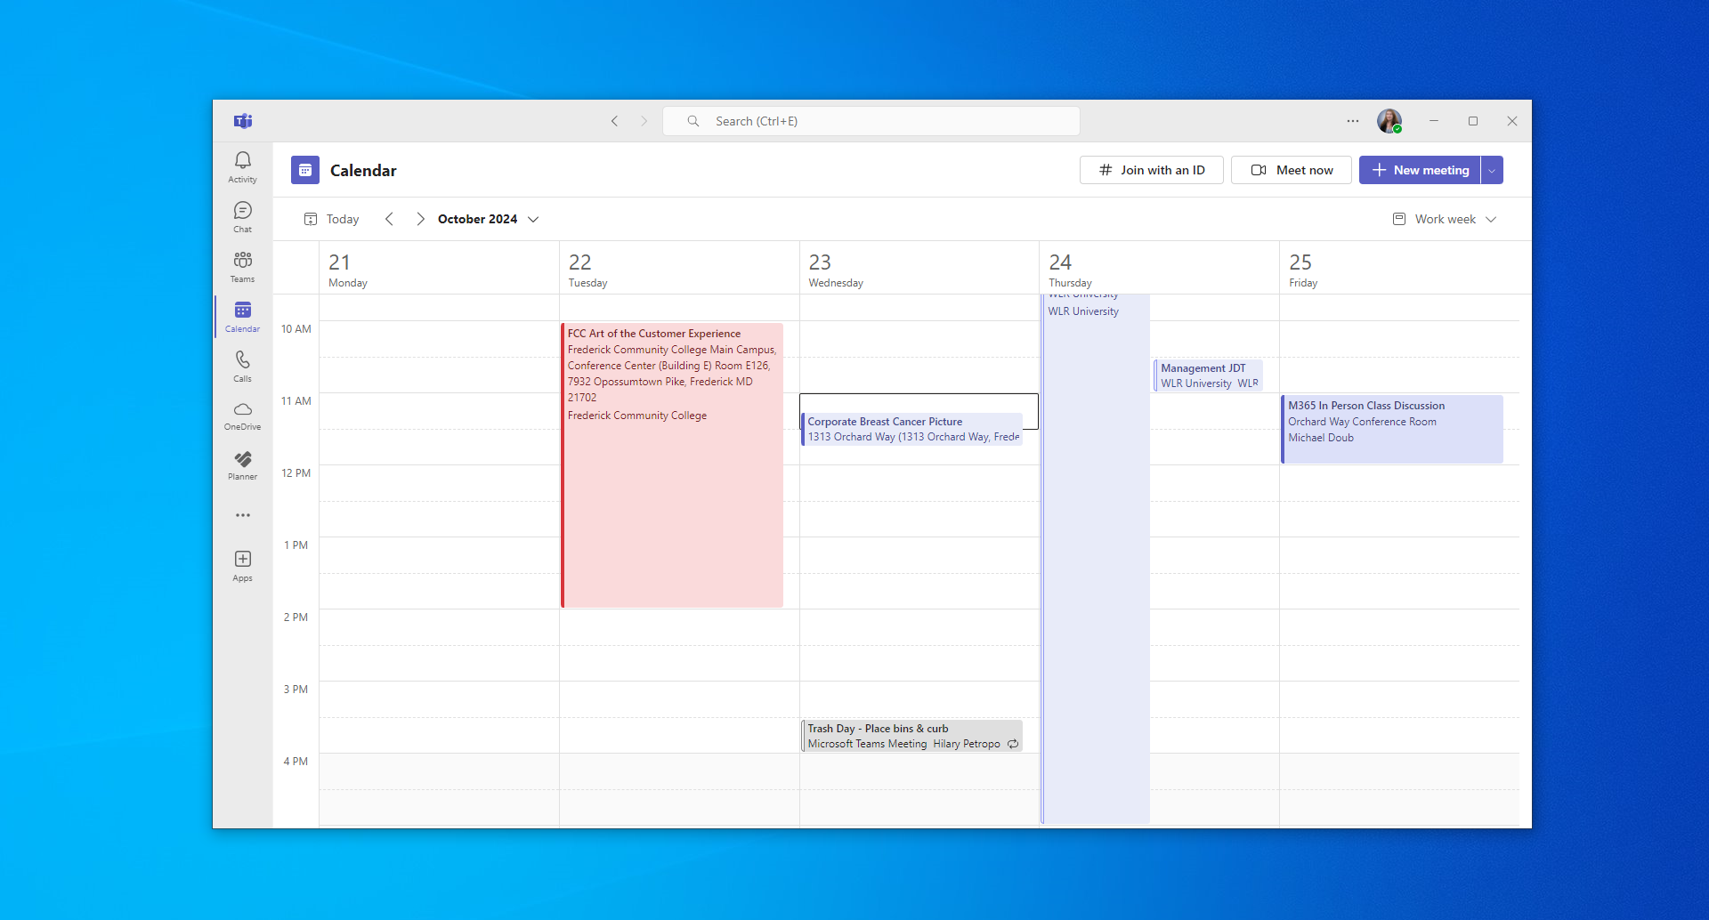

Slide 31
(Q2)
After opening a new meeting draft, where do you click to set your availability status for time blocking?

Slide 32
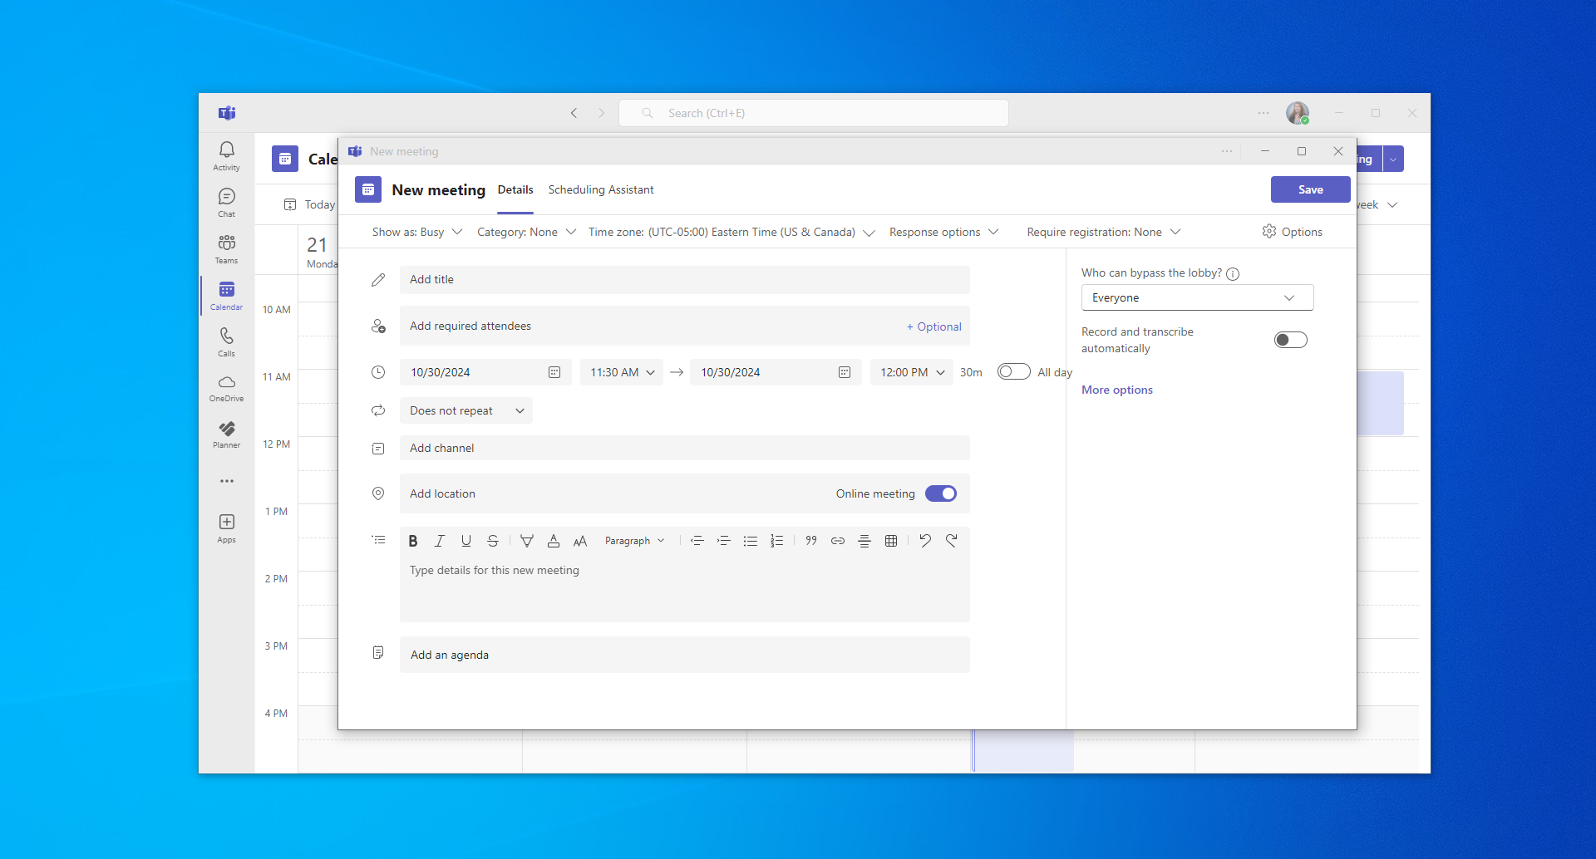

Slide 33
(Q3)
After opening a new meeting draft, where do you click to color code the meeting?

Slide 35
(Q4)
After opening a channel within the Teams tab, where do you click to access the posts for that channel?

Slide 36
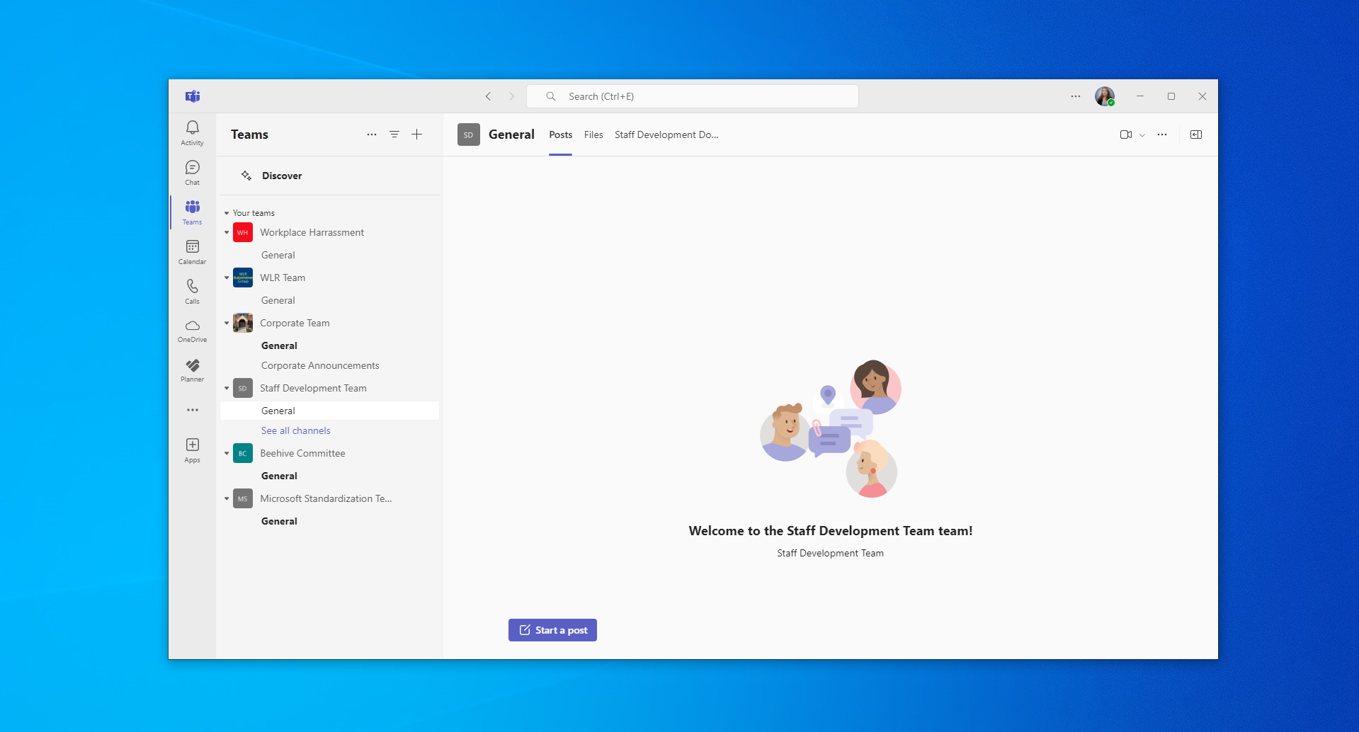

Slide 37
Teams Mobile App Features
A Brief Overview
As a reminder, the Teams mobile app has a variety of helpful features, including:
  Opening Planner and your activity feed
  Scheduling quiet time
  Creating audio messages
  Using the camera and its photo editing features
  Transferring a meeting from your desktop to a mobile device
  Sharing your screen from a mobile device
If you would like to further explore the possibilities of your Teams mobile app, feel free to schedule a one-on-one meeting with Business Applications!
Notes:
How to join a Teams meeting with a second device (these will be first bc you see this and below option first when you join a meeting on mobile device)
How to share screen from a mobile device
Create a test meeting probably for them to join for the last two objectives
Do not tell them there is no knowledge check assessment - don't want to impact encoding

Slide 38
Optional Q&A and One-on-One Support
Opportunity for Questions and Extra Help
Thank you for your hard work and engagement! Whether you stay or leave, please remember to:
  Complete your practice activities in the Litmos course before the two-week deadline
  Complete the post-training survey that will be emailed to you tomorrow
  Reach out to the Business Applications team with any follow-up questions

