Slide 1
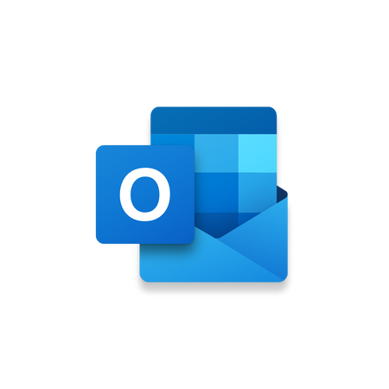

Microsoft 365 Optimization Training
Welcome! The purpose of your Microsoft 365 Optimization Training is to support you as WLR transitions to using new versions of Outlook and Planner in Teams. Your overall training experience will consist of first exploring the online slides of this Litmos course. Then, you will participate in two in-person training sessions, where the first session will focus on Outlook and the second session will focus on Teams. After each training session, you will practice with supplemental activities, which are also located in this Litmos course and will unlock following each session.
As you complete your training, please remember that the Business Applications team is here to support you! The BA team will help you adapt to the new features and standardization initiatives that will optimize how we all use these Microsoft 365 apps. To start your training, please go to the next slide for instructions on how to switch to the New Outlook.

Slide 2
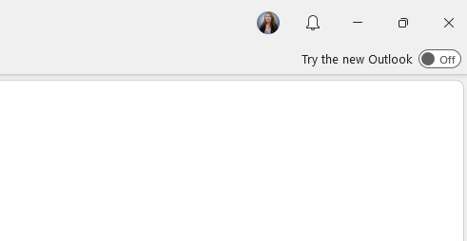

How to Switch to New Outlook
To switch from your current Outlook inbox to New Outlook, click the “Try the new Outlook” toggle at the upper right corner of your inbox, as seen in the image to the right.
Please note that once you switch to New Outlook, you can still access your original inbox by searching on your desktop for the app “Outlook (classic)”.

Slide 3
New Outlook Introduction
The New Outlook section of this course is split into three modules, which are reviewed more in-depth on the next slide. As you explore these modules, please start to practice using both the features covered in this training and any other features not covered that are applicable to your work. Through this initial exploration, you will be able to prepare any questions for the Q&A portion of the in-person training session and engage fully with the opportunity for one-on-one support.
Additionally, please review the information in these modules thoroughly enough that you feel confident at the in-person training session. At the session, you will be practicing and ultimately demonstrating mastery of fundamental skills for using New Outlook!

Slide 4
New Outlook Overview
(1) Introduction to Planner & Customizing New Outlook
  How to access Microsoft Planner through New Outlook
  How to customize the appearance of New Outlook
  How to adjust your notification preferences
(2) Standardizing Your Calendar & Scheduling Meetings
  How to effectively time block in your calendar
  How to color code calendar events
  How to schedule events based on attendee availability
(3) Optimizing Outlook Email & Inbox Automations
  How use commands when writing an email
  How to schedule and recall an email
  How to create a OneNote note from an email
  How to set up and use inbox automations

Slide 5
(1)
Introduction to Planner & Customizing New Outlook
This module will explore how New Outlook can help you start using Microsoft Planner. Planner is a tool that will help you effectively manage your tasks separately from your calendar. This module will also cover a few helpful tips, such as how to set your notification preferences.

Slide 6
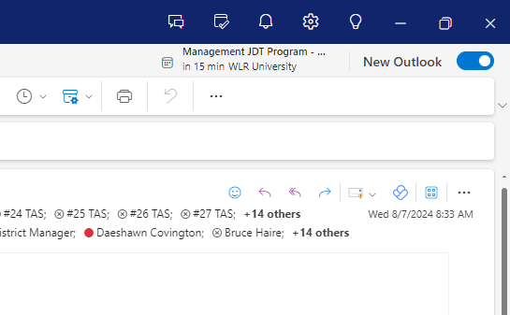
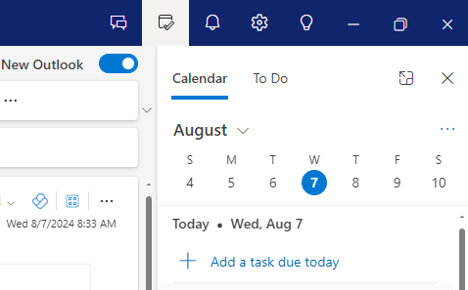
How to Open the Calendar Shortcut in Outlook
In Outlook, features of Planner are easily accessible from your calendar shortcut. To access this shortcut, follow these steps:
  Open the Outlook desktop app on your computer
  Locate the toolbar at the top right of the screen, as seen in the left image below
  Click the icon of the calendar with a checkmark, as seen in the right image below

Slide 7
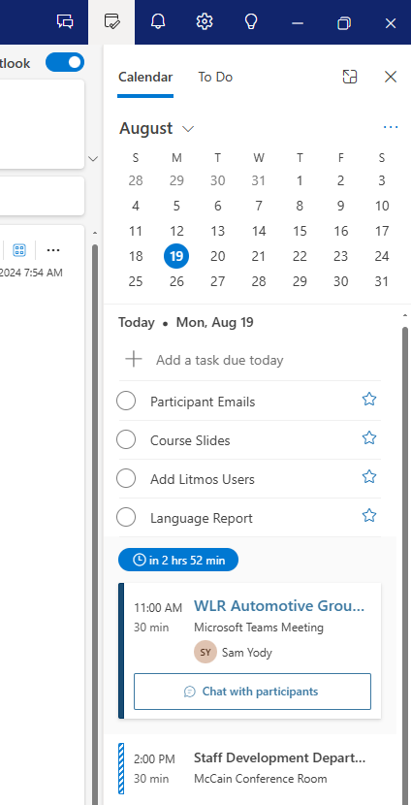
Where to Find Planner Tasks in Outlook
Your calendar shortcut will appear on the right side of Outlook as a panel window. Any tasks in Planner will appear on this panel, as seen in the image to the right. This panel will also show any events scheduled in your calendar, allowing you to keep track of tasks and meetings all in one place.

Slide 8
How to Add Tasks to Planner from Outlook
From your calendar shortcut in Outlook, you can also add new tasks. To add a new task in Outlook, follow these steps:
  Click “+ Add a task due today,” as seen in the image to the right
  Type the name of the new task
  Press the enter button on your keyboard

Slide 9
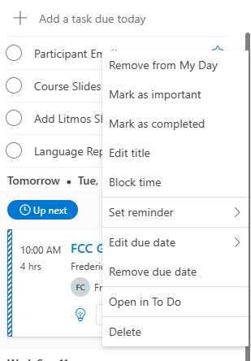
How to Change the Due Date of Tasks from Outlook
For any tasks you create in Outlook, the default due date is the present day. To change the due date of a task, follow these steps:
  From your calendar shortcut, right click on a task to open an options menu, as seen in the image to the right
  Click “Edit due date” to change the due date of the task

Slide 10
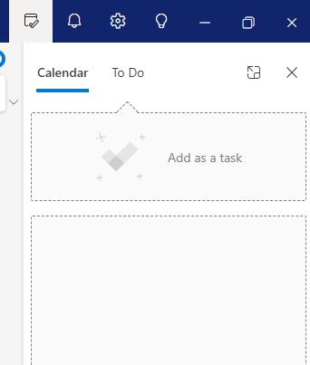
How to Create a Task from an Email
Creating a task from an email is helpful for when you want a reminder to address the email. To create a task from an email, you have two options. The first option is to simply flag the email, which will automatically create a task.
The second option is to click and drag the email to your calendar shortcut. When you start to click and drag the email, a box will appear that says “Add as a task,” as seen in the image to the right. Drag the email to this box to create a task.

Slide 11
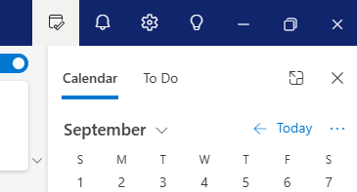
Additional Toolbar Shortcuts for Outlook
Along with the calendar shortcut, the toolbar at the top right of your screen has additional helpful icons to assist you with the Microsoft 365 transition.
  The Bell Icon
    The bell icon will show you notifications, emails, and @ messages from across Microsoft tools.
  The Gear Icon
    The gear icon will open Settings for Outlook. Take note that you will need to access Settings multiple times throughout this course!
  The Lightbulb Icon
    The lightbulb icon will open the insight tab. You can use the insight tab for any questions you may have about using and understanding Outlook.

Slide 12
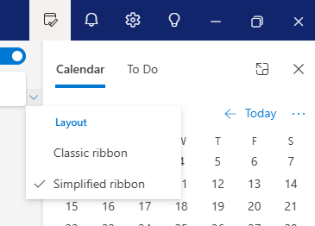
How to Customize Your Ribbon Layout
Your ribbon is the field above your inbox that includes a variety of shortcuts, such as creating, deleting, and replying to an email. When you switch to the new Outlook, you will automatically have the simplified ribbon, which is a condensed layout. If you would prefer your ribbon to be expanded, such as through including larger icons for each shortcut, follow these steps:
  Open your calendar shortcut
  Click the small downward arrow button next to “Calendar,” as seen in the image to the right
  Click “Classic ribbon” to change your ribbon to the original layout

Slide 13
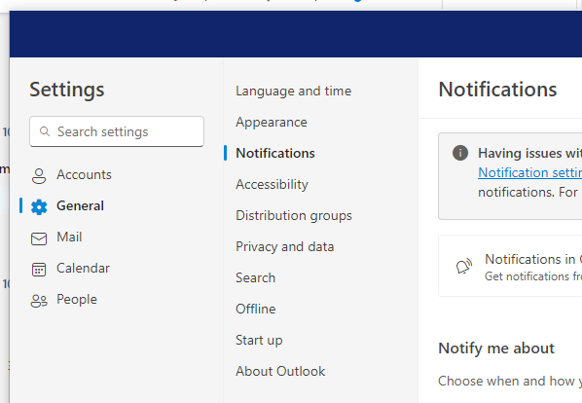
How to Customize Your Outlook Notifications
To customize your notifications, such as for emails and event reminders, follow these steps:
  Open Settings by clicking the gear icon on the toolbar
  In Settings, click “General,” as seen in the image to the right
  Click “Notifications“
  Select the applicable toggle buttons to switch notifications on and off

Slide 14
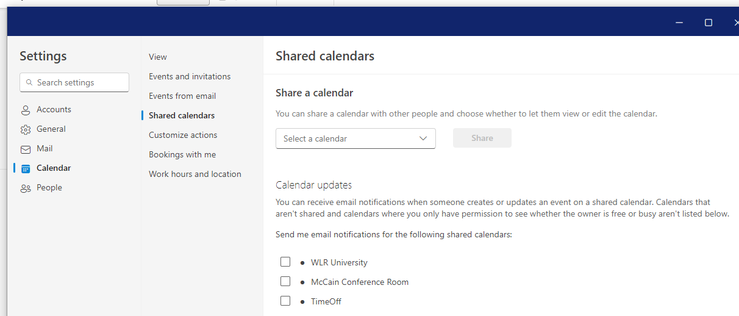
How to Set Up Shared Calendar Notifications
You can also receive email notifications for calendars that others have shared with you. To activate shared calendar notifications, follow these steps:
  Open Settings
  Select “Calendar,” as seen in the image below
  Select “Shared calendars”
  Click the checkbox for each calendar you want to be notified about

Slide 15
(2)
Standardizing Your Calendar & Scheduling Meetings
Now that you’ve reviewed the new Outlook, it’s time to explore how to optimize your calendar. This module includes best practices for creating calendar events and a variety of tools to quickly schedule meetings.

Slide 16
Why Is It Important to Move My Tasks from Calendar to Planner?
Currently, when a task is put on your calendar for time blocking, it interferes with the ability to effectively schedule meetings. Whenever a task is scheduled as an event, you are most likely still available for a meeting at that time. However, when you or a colleague is trying to schedule a meeting, you will appear as unavailable for whenever the task is scheduled.
So, by moving tasks out of your calendar to Planner, everyone will be able to easily schedule meetings without questions about someone’s availability. This transition will also ensure proper functioning of the tools you can use to schedule meetings. We will explore these tools later in this module, including your Scheduling Assistant!

Slide 17
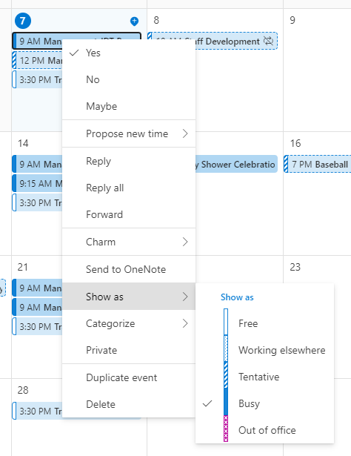

How to Effectively Use Time Blocking in Your Calendar
Over time, you will grow more comfortable with using Planner for your tasks. For now, an action you can take today is editing your availability for any events that are time blocking for tasks. Unless you are truly not available, follow these steps:
  In Outlook, open your calendar (not the calendar shortcut)
  Right click on each event that is a task to open an options menu
  Locate “Show as” and click “Free,” as seen in the image to the right
For any shared calendars and events from others, such as time off and activities, you will need to complete these steps as well. This will ensure that any shared events also do not interfere with scheduling.

Slide 18
Table for Color Coding Your Calendar Events
Along with standardizing how we manage our tasks, it’s important to properly color code calendar events. By following the color codes of WLR, you will help everyone and any future AI processes easily understand your calendar. The color codes for each type of event are found in the table to the right.
You can use anything outside of these standard colors for your own personal use.
Event | Color Name
Conference Call/Phone Call | Plum (Magenta)
Corporate Event | Steel (Blue)
External Meeting | Cranberry (Red)
Internal Meeting | Sky Blue
Leadership/DH Out of Office | Peach (Orange)
Location Updates | Gold
Marketing Event | Dark Blue

Slide 19
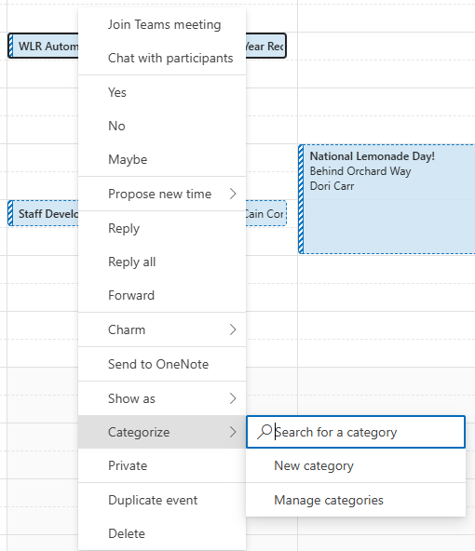
How to Color Code Your Calendar Events
To edit the color of a calendar event, follow these steps:
  Open your Outlook calendar (not the shortcut)
  Right click on the event you want to color code. An options menu will appear
  Locate “Categorize” and click “New category,” as seen in the image to the right. This will open the color category menu

Slide 20
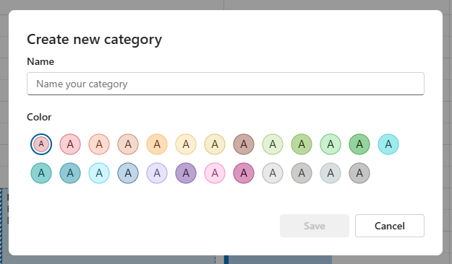
How to Color Code Your Calendar Events (Cont.)
4. From the “Create new category” menu, as seen in the image to the right, you can create a color category for each event type. Simply name the category the type of event and select its corresponding color; hover your cursor over each color option to see its specific name. An example category you will create is one named “External Meeting” with the color cranberry red
5. Click “Save” at the bottom right of the menu to save the color category

Slide 21
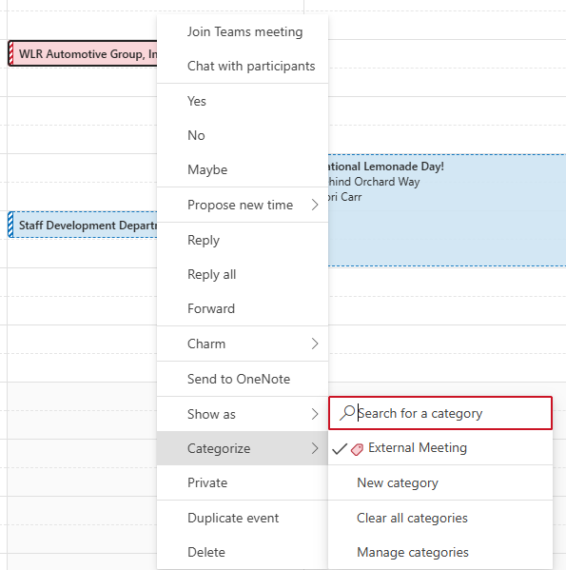
How to Color Code Your Calendar Events (Cont.)
Please note that you will not have to repeat all of these steps every time you color code a calendar event. Once you create a color category, it will appear under “Categorize,” as seen in the image to the right.

Slide 22
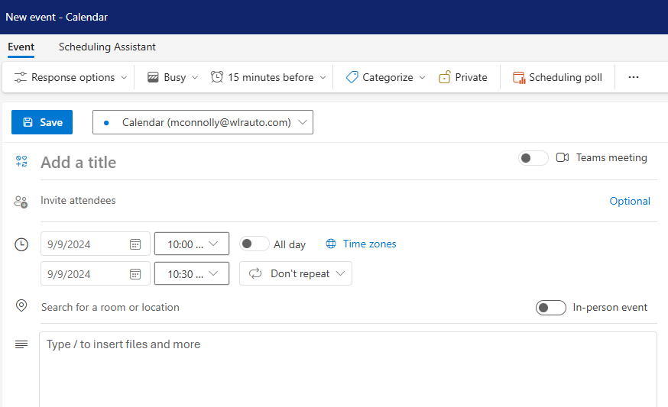
How to Schedule In-Person vs. Virtual Meetings
Another way to standardize your calendar events is to set them as either an in-person or virtual meeting. While you may not currently use virtual meetings often, WLR is working to embrace AI, and Microsoft’s AI assistant Copilot will be especially helpful during virtual meetings. So, to set a meeting as either in-person or virtual, follow these steps:
  Open a new calendar event
  Select the applicable toggle for your event, as seen in the image to the right. For a virtual meeting, select the toggle for “Teams meeting.” For an in-person meeting, select the toggle for “In-person event”

Slide 23
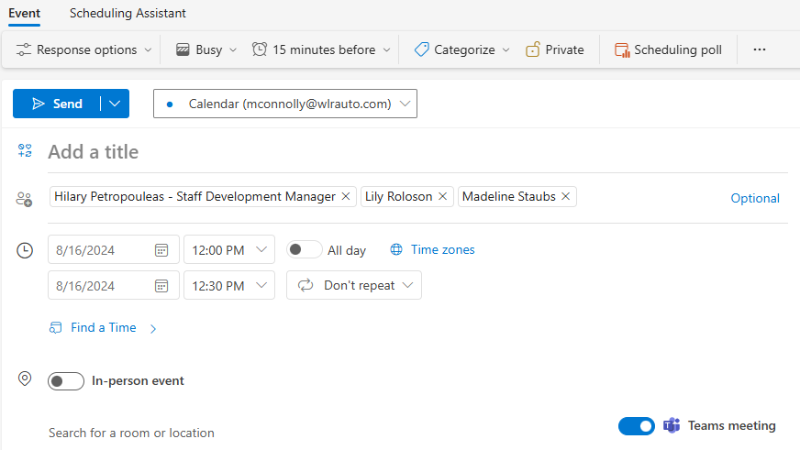
How to Schedule Meetings Based on Attendee Availability
You have three tools that can help you easily schedule meetings based on your attendees’ availability. The first we will explore is the “Find a Time” feature when creating a new event. To use this feature, follow these steps:
  Open a new calendar event
  Add your attendees and select a location for your meeting, if applicable
  Click “Find a Time,” as seen in the image to the right. You will be automatically provided with meeting times that work with everyone’s schedule and the availability of the meeting location you chose

Slide 24
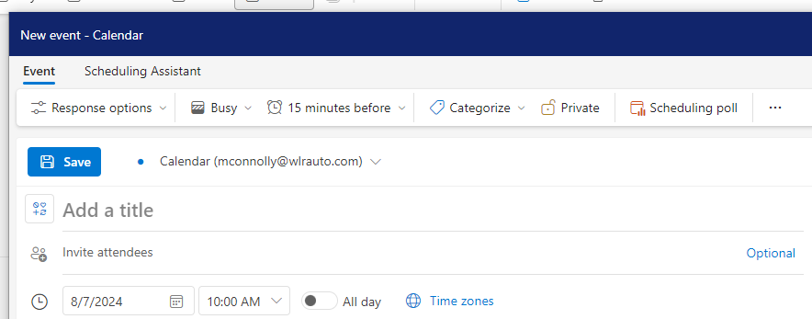
How to Use the Scheduling Poll for Meetings
The second tool we will explore is the scheduling poll. The scheduling poll allows you to send a poll to attendees with meeting time options. If everyone selects the same meeting time, the meeting will be automatically booked. If not, you can use the results of the poll to choose the most appropriate time or to resend the poll with new times, if needed. To use the scheduling poll, follow these steps:
  Create a new calendar event and add your attendee(s)
  Click “Scheduling poll” at the top of the new event, as seen in the image below. This will open the scheduling poll panel

Slide 25
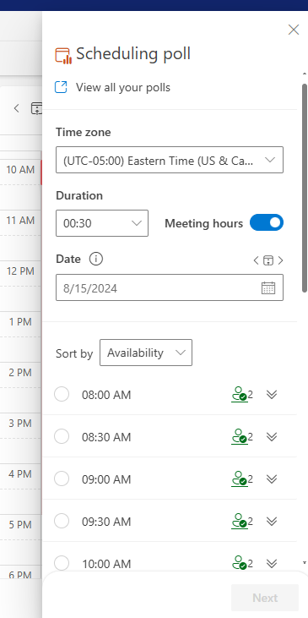
How to Use the Scheduling Poll for Meetings (Cont.)
4. From the scheduling poll panel, select the duration and date of the meeting, as seen in the image to the right
5. Once you select the duration and date, the poll will generate suggested meeting times based on everyone’s availability
6. Click the circle button for each time that you want to add to the poll
7. Click “Next” at the bottom of the panel

Slide 26
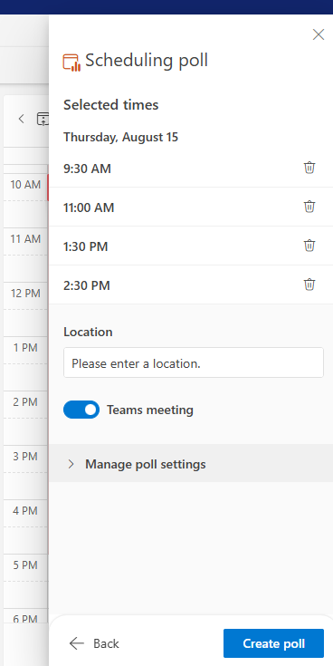
How to Use the Scheduling Poll for Meetings (Cont.)
8. If you are scheduling an in-person meeting, toggle off the “Teams meeting” option, as seen in the image to the right. Please note that, unlike the previous scheduling option, the “Location” field will not account for room availability. So, when using the scheduling poll, you will need to check meeting room availability yourself
9. Click “Create poll” at the bottom of the panel to send the poll to attendees

Slide 27
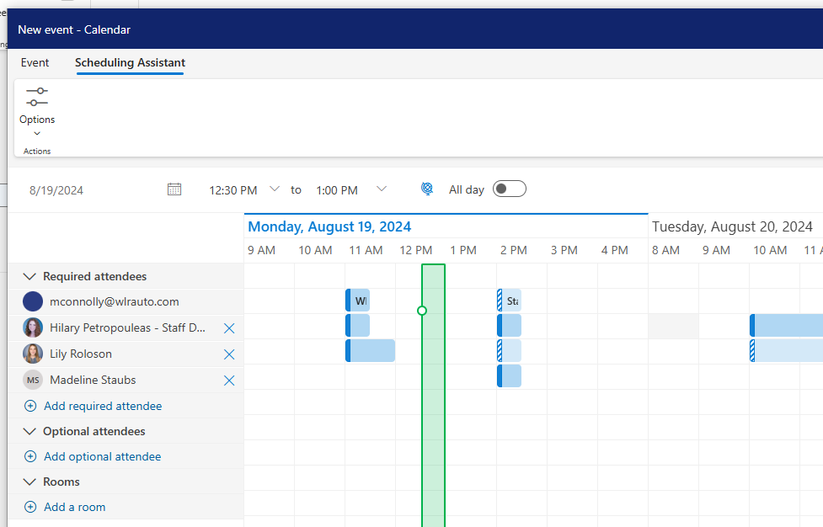
How to Use the Scheduling Assistant for Meetings
The third and final tool we will explore is the Scheduling Assistant. To use the Scheduling Assistant, follow these steps:
  Open a new calendar event
  At the top left corner, click “Scheduling Assistant,” as seen in the image to the right
  Add your attendees and meeting location, if applicable
  Drag the bar over the calendar to find a time when all attendees are available. The bar will be green when it is slid over a time slot where everyone is available
Please note that you cannot schedule a meeting directly from the Scheduling Assistant. You will need to complete the new calendar event that you opened in Step 1.

Slide 28
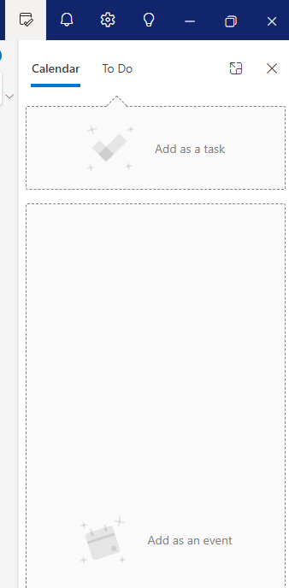
How to Create an Event from an Email
Similarly to how you create a task from an email, you can also create an event from an email. Simply click and drag the email to your calendar shortcut and place it in the “Add as an event” box, as seen in the image to the right. This will automatically create a new event window for you to complete. Remember to properly color code the event, select either the in-person or virtual meeting toggle, and use the scheduling tools we’ve explored!
This option is great for when you need to set up a meeting for more context or information about the email. You can also use this feature when you want to create a meeting that will reference the email in the event text box.

Slide 29
(3)
Optimizing Outlook Email & Inbox Automations
This final module about Outlook will explore a variety of helpful tips and automations for writing emails and managing your inbox.

Slide 30
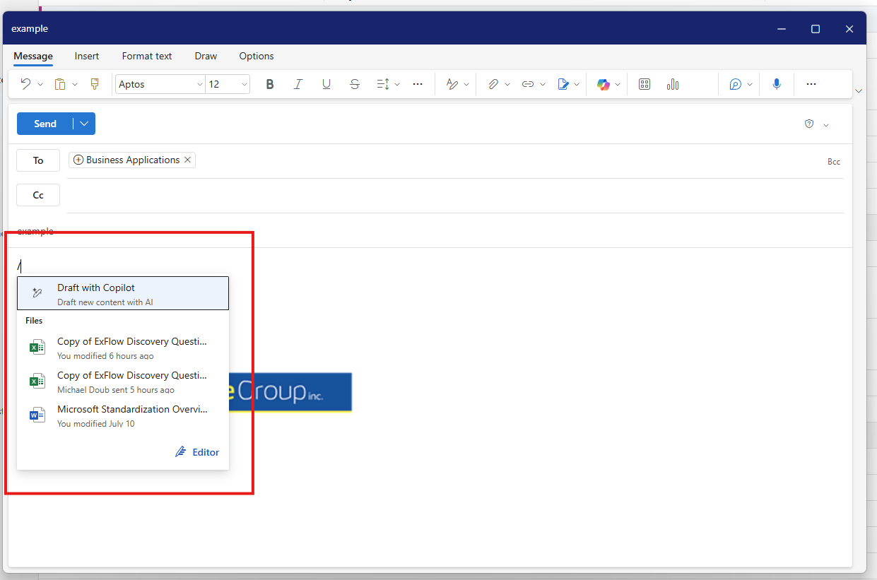
How to Use Commands When Writing an Outlook Email
The commands tab is one way to optimize efficiency when writing emails. To open your commands tab, press the forward slash key “/” in the email draft, as seen in the image below. From the commands tab, you will be able to quickly insert a file or draft a response with Copilot. Please note that you may not have access to Copilot yet.

Slide 31
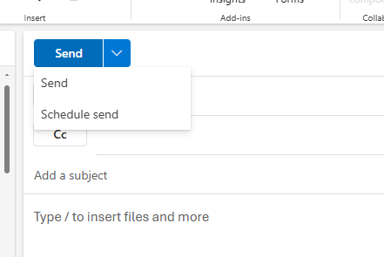
How to Schedule Emails in Outlook
Another important feature is scheduling an email to be sent at a later time. Scheduling emails is helpful for follow-up emails or for when you are working during off-work hours and need to schedule the email for when the recipient is working. To schedule an email, follow these steps:
  Open a new email draft
  Write your message and add your recipient(s)
  Click the blue downward arrow button next to “Send,” as seen in the image to the right
  From the dropdown, click “Schedule send” to schedule the time you want the email to be sent

Slide 32
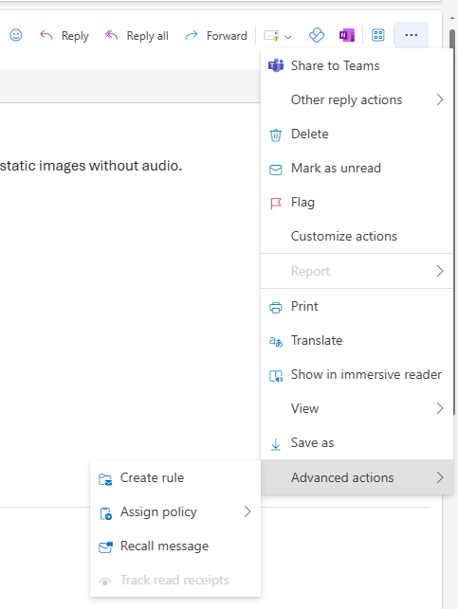
How to Recall a Sent Email in Outlook
Outlook now gives you greater control over unintentional errors in your emails by letting you recall a sent email. To recall a sent email, follow these steps:
  Open the sent email in your inbox
  Click the three dots at the top right corner of the email, as seen in the image to the right
  Locate “Advanced actions” and click “Recall message”
Please note that if the recipient has already read your message, recalling the email at that point will not have an effect.

Slide 33
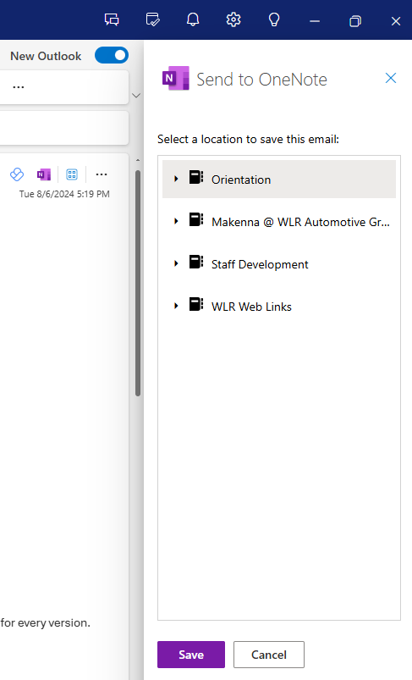
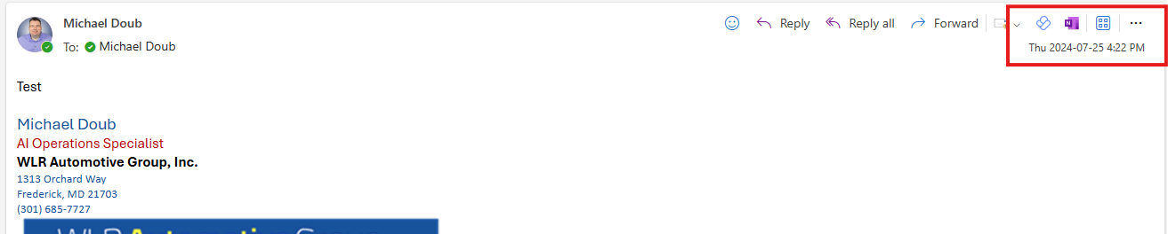
How to Transfer an Email to OneNote
One final feature that can improve how you use your email involves OneNote. To convert an email to a OneNote note, follow these steps:
  Open the email that you would like to send to OneNote
  In the top right corner of the email, click the OneNote app icon to open a panel, as seen in the left image below. (If you do not see the OneNote app icon, please go to the next slide of this course for instructions.)
  From the panel, click the OneNote folder that you want to send the email to, as seen in the right image below
  Click the “Save” button below the folder options

Slide 34
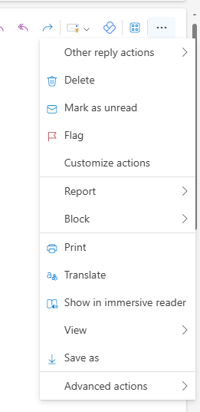
If You Are Missing the OneNote Email Feature
If you are currently unable to create a OneNote note from an email, follow the steps on this slide and the next slide:
  Select any email in your inbox
  Click the three dots at the top right corner of the email, as seen in the image to the right
  Click “Customize actions.” This will open a new pop-up pane

Slide 35
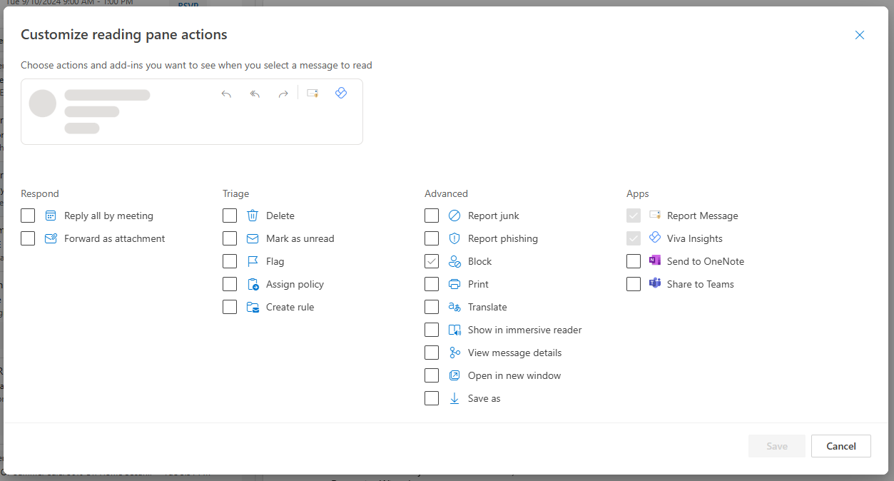
If You Are Missing the OneNote Email Feature (Cont.)
4. From the pop-up pane, select the checkboxes for both OneNote and Teams, as seen in the image below. Selecting Teams will allow you to share an email with Teams as well
5. Click “Save” at the bottom right of the pop-up pane

Slide 36
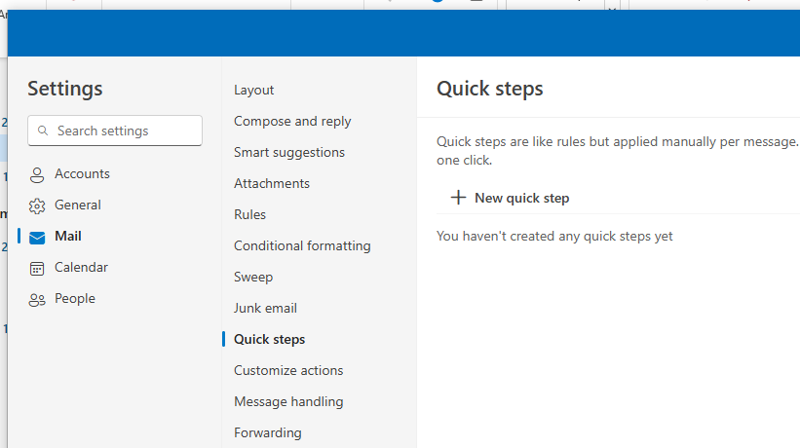
How to Set Up Quick Steps for Inbox Automation
Along with optimizing how you write and interact with emails, you have a variety of options for automating your inbox. We will explore four types of automations, starting with quick steps.
Quick steps can replace repetitive manual processes in your inbox through simply pressing a few buttons. For example, you can set up quick steps for deleting an email, flagging an email, and creating a Planner task from an email. To set up one or more quick steps, follow these steps:
  Open Settings
  Click “Mail,” as seen in the image to the right
  Click “Quick steps”
  Click “+ New quick step”

Slide 37
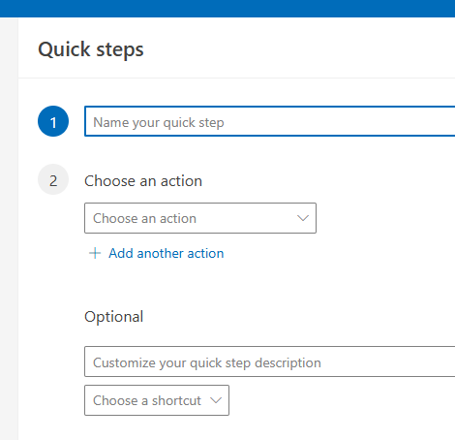
How to Set Up Quick Steps for Inbox Automation (Cont.)
5. On the “Quick steps” menu, give your quick step a name in the “Name your quick step” text box, as seen in the image to the right
6. From the “Choose an action” dropdown, select the action you want your quick step to perform
7. While optional, you are encouraged to choose a shortcut for your quick step to maximize efficiency. This shortcut will allow you to press Control + Shift + a number 5 through 9 to activate a quick step. To create a shortcut for your quick step, click the “Choose a shortcut” dropdown and select a shortcut

Slide 38
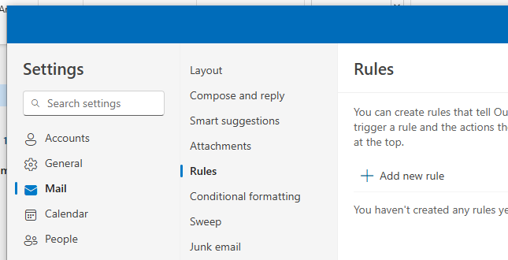
How to Set Up Rules for Inbox Automation
The next inbox automation we will explore is rules. Rules are great for when you often complete a specific action with emails from a specific sender. For example, you can create a rule to automatically send emails from a specific person or team to a specific folder. To start exploring the possibilities with rules, follow these steps:
  Open Settings
  Click “Mail” and then “Rules,” as seen in the image to the right
  Click “+ Add new rule” to open a menu similar to the quick steps menu. We encourage you to explore all of the different rules you can create for your inbox!

Slide 39
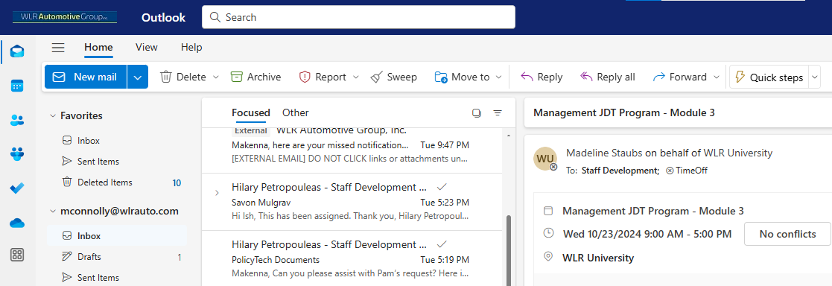
How to Use Sweep for Inbox Automation
It’s important to remember that if you set up a rule to automatically send emails to a folder, those emails will not appear in your main inbox. So, you may miss those emails if you forget to check the folder. An alternative option is the sweep function, which provides more control over when emails are sent to a folder. Sweep is essentially a manual version of setting up an automatic folder rule; you decide when emails in your inbox are “swept” to a specific folder. To use sweep, follow these steps:
  Select an email in your inbox
  Navigate to your ribbon and click “Sweep,” as seen in the image below. This will open an options menu

Slide 40
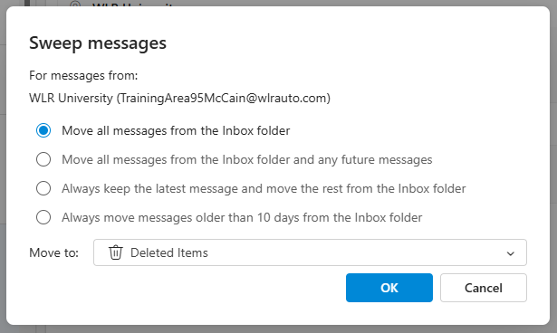
How to Use Sweep for Inbox Automation (Cont.)
3. From the options menu, as seen in the image to the right, choose which sweep function you would like to perform. The sweep will apply to all emails sent from the sender of the initial email you selected
4. From the “Move to” dropdown, select where you want the emails to go
5. Click the blue “OK” button to activate the sweep

Slide 41
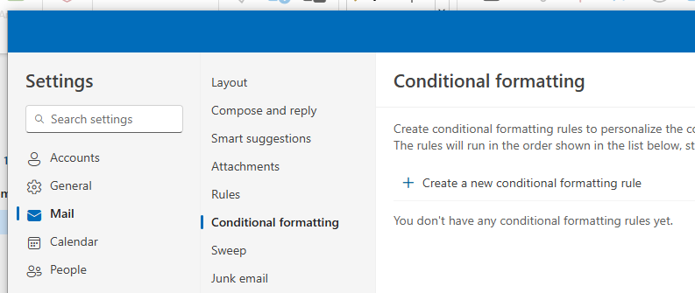
How to Set Up Conditional Formatting for Inbox Automation
The final inbox automation we will explore is conditional formatting. Conditional formatting allows you to color code your emails based on a variety of conditions, such as if the email is from a specific sender or if you’re CC’d on an email. By setting up conditional formatting, you can more easily recognize different types of emails in your inbox. It can also help you stay alert to important emails that need your attention! Unlike color coding your calendar events, there are no current standards for color coding your emails, so feel free to experiment as you wish. To set up conditional formatting, follow these steps:
  Open Settings
  Click “Mail” and then “Conditional formatting,” as seen in the image below
  Click “+ Create a new conditional formatting rule” to open the form for creating conditional formatting

