Slide 1
Teams Overview
(1) In-Depth Review of Microsoft Planner
  How to navigate Planner in Teams
  How to edit and add details to tasks
  How to create and add tasks to plans
(2) Scheduling a Meeting in Teams
  How to open your calendar and schedule meetings
  How to adjust meeting settings
  How to accept meeting invitations
(3) Teams Messaging & AI Features
  How to standardize internal and external communications
  How to explore new AI chat features
(4) Teams Mobile App Features
  How to access Planner in the Teams mobile app
  How to manage notifications
  How to create audio and visual messages
  How to connect your mobile device and desktop

Slide 2
(1)
In-Depth Review of Microsoft Planner
This module will explore the future of task management at WLR and review Planner’s three main features: “My Day,” “My Tasks,” and “My Plans.”

Slide 3
The Future of Microsoft Planner and Monday.com
Planner allows you to keep track of tasks, create plans, and manage your daily schedule. Microsoft Project, another project management software, will soon be absorbed into Planner. Despite the current and future project management capabilities of Planner, WLR projects will remain in Monday.com through at least November of 2025.
If WLR makes the transition from Monday.com to Planner, there will be additional resources and trainings focused on the project management capabilities for larger projects. For the remainder of this course, we will instead explore how Planner can support smaller projects and your day-to-day responsibilities.

Slide 4
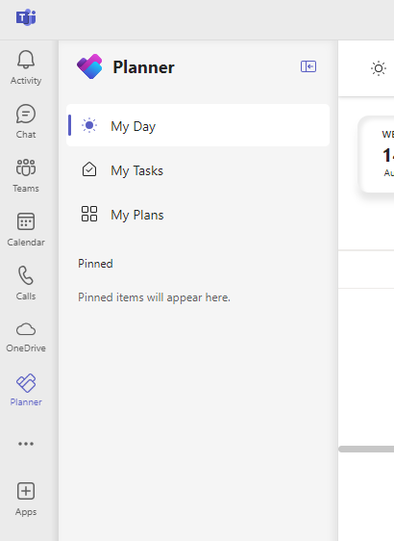

How to Open Planner in Teams
To open Planner in Teams, follow these steps:
  Open the Teams desktop app on your computer
  On the left side menu of Teams, click “Planner,” as seen in the image to the right
Of the three main features of Planner, the first we will explore is My Tasks.

Slide 5
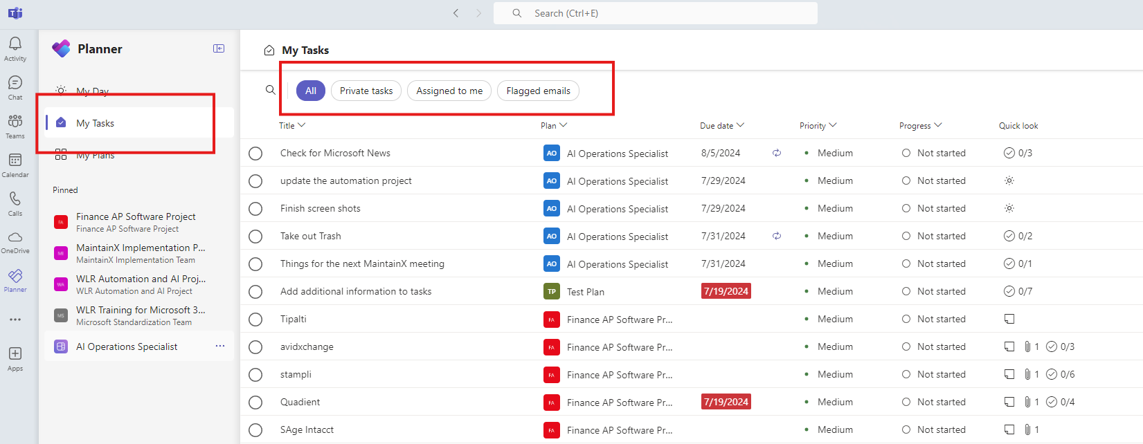
How to Find and Filter Tasks in Planner
On the left side panel of Planner, the My Tasks tab is where you can find your tasks, as seen in the image below. To sort through your tasks, you can click “Private tasks,” “Assigned to me,” or “Flagged emails” at the top of your My Tasks page.
“Private tasks” will show tasks you have created yourself, “Assigned to me” will show tasks that others have assigned to you, and “Flagged emails” will show tasks created from flagged emails in Outlook.

Slide 6
How to Find Task Details in Planner
In My Tasks, you can find a variety of details about your tasks. For example, you can view and edit the title of a task, as seen in the image below. To mark a task as complete, click the circle button next to the task’s name.

Slide 7
How to Find Task Details in Planner (Cont.)
If a task is attached to a specific plan, you will be able to see that information as well. Plans and the My Plans tab will be explored shortly.

Slide 8
How to Find Task Details in Planner (Cont.)
Towards the right side of your My Tasks page, you can see the due date for a task, its priority level, and its progress status. Any tasks that have the due date highlighted in red are past due and need your attention as soon as possible.

Slide 9
How to Find Task Details in Planner (Cont.)
The final column in My Tasks is “Quick look,” which is where you can find any file attachments that have been added to a task. Additionally, a sunshine icon will appear in this column for any tasks that are due the present day. The sunshine icon is linked to the My Day tab, which we will also explore in this module.

Slide 10
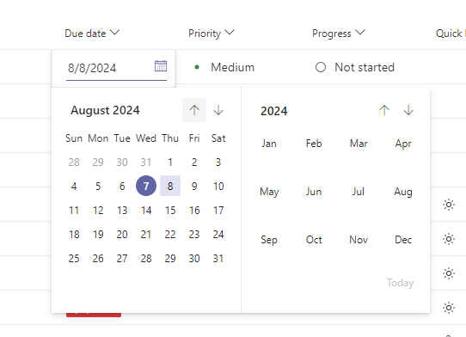
How to Change the Due Date of a Task
In My Tasks, you can also change the due date of a task. In the “Due date” column, hover your cursor over the date of the task you want to change; a calendar icon will appear, as seen in the image to the right. Click the calendar icon and change the due date of the task.
Please note that if you are changing the due date of a task that someone else assigned to you, make sure you have approval to change the due date of the task.

Slide 11
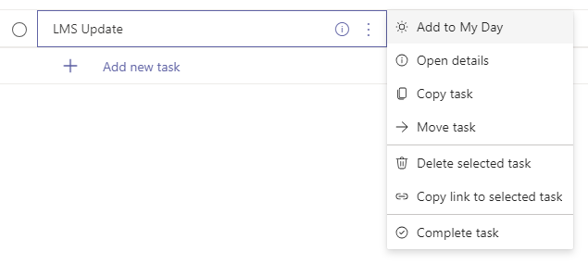
How to Open Task Cards
A task card is where you can add additional details to a task, such as notes and file attachments. You can make task cards as simple or complex as you’d like; it’s just important to start using tasks! To open a task card, follow these steps:
  Open My Tasks
  Locate which task you want to open the task card for
  In the “Title” column, hover your cursor over the title and click the three dots, as seen in the image below
  Click “Open details” to open the task card

Slide 12
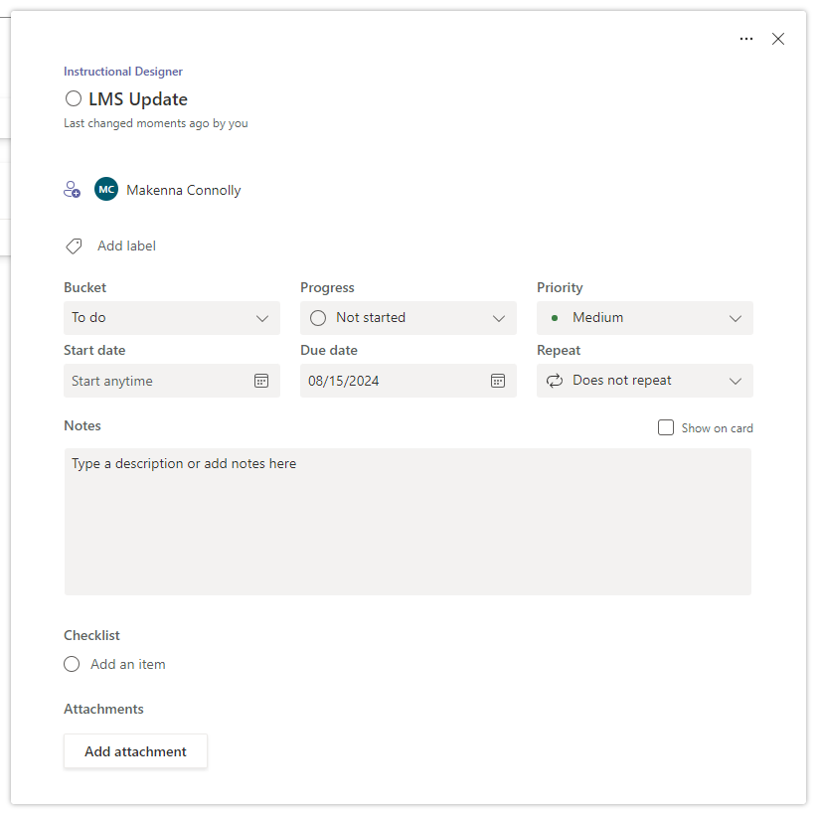
How to Create Recurring Tasks
For any recurring tasks, such as weekly reports and reminders to take out the trash, you can set how often these tasks repeat. To create a recurring task, follow these steps:
  Open the task card for the task
  From the “Repeat” dropdown, as seen in the image to the right, select whether the task repeats daily, weekly, etc.

Slide 13
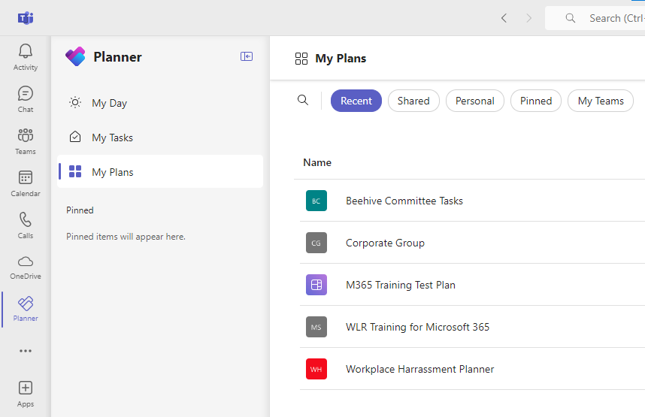
How to Create a Plan in My Plans
In My Plans, you will find plans that you have either created yourself or plans that someone else added you to. In these plans, you can create tasks and assign them to yourself for easy tracking or assign tasks to someone else. To create a plan for your specific position at WLR, follow these steps:
  Click on the My Plans tab in Planner, as seen in the image to the right

Slide 14
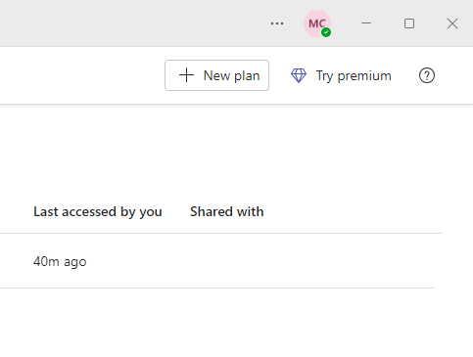
How to Create a Plan in My Plans (Cont.)
2. Click “+ New plan” at the top right corner of the My Plans page. This will open a pop-up window for creating a plan

Slide 15
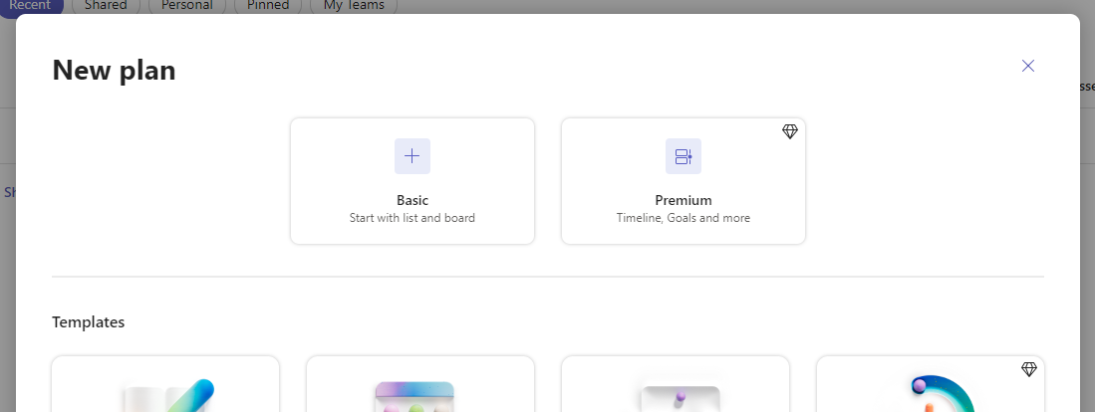
How to Create a Plan in My Plans (Cont.)
3. From the pop-up window, select “Basic” for your new plan

Slide 16
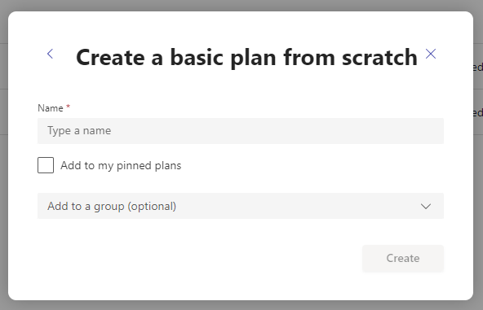
How to Create a Plan in My Plans (Cont.)
4. In the “Name” text field, name the plan your job title
5. Check the box for "Add to my pinned plans." This will pin the plan to the left side menu of Planner for easy access
6. Click “Create” to create and open your new plan

Slide 17
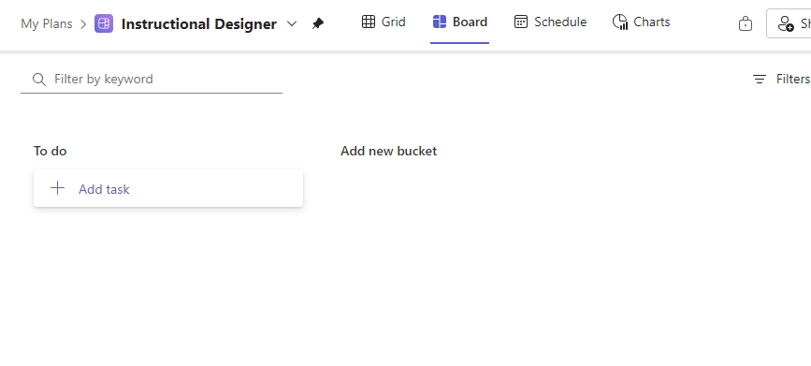
How to Create Buckets to Organize Tasks in a Plan
Buckets can help you organize your tasks within a plan through creating different columns. The default bucket when you create a plan is “To do.” To create additional buckets, follow these steps:
  From a plan, click “Add new bucket,” as seen in the image below
  Type the name of the new bucket
  Press the enter button on your keyboard to save the bucket

Slide 18
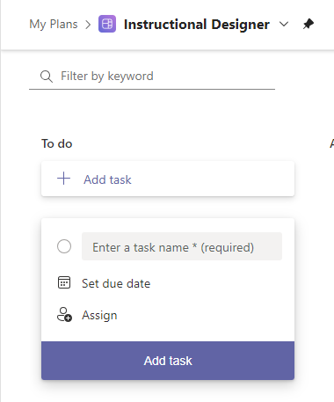
How to Assign Tasks through My Plans
When you open a specific plan, such as the one you just created, there will be a column labeled “To do.” Here, any tasks you assign to yourself or others will be associated with the specific plan. To assign tasks, follow these steps:
  Open the applicable plan
  Locate the “To do” column, as seen in the image to the right
  Click “+ Add task”
  Enter the task name and set a due date
  Click “Assign” and add who you are assigning the task to
  Once complete, click “Add task”

Slide 19
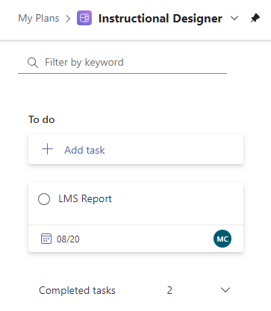
How to Find Completed Tasks in My Plans
When you mark a task as complete in a plan’s To do list, it will be saved in “Completed tasks,” as seen in the image to the right. Click the downward arrow button to see all of the tasks you have completed.
This feature is helpful for action reviews of your previous work so that you can continue to grow and improve.

Slide 20
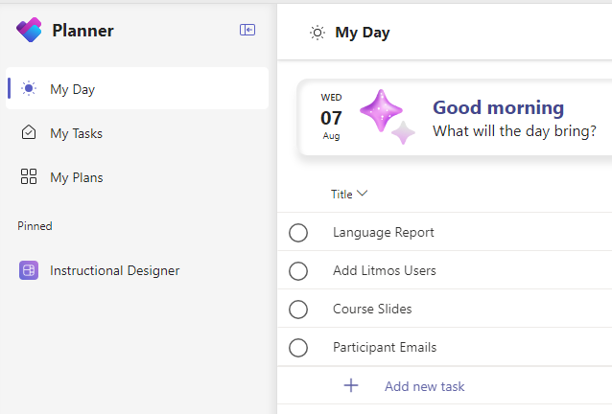
How to Use My Day in Planner
The final section of Planner is My Day. My Day will show you all of the tasks that are due for the present day. In My Day, you can easily check off tasks as you progress throughout your work day. To open My Day, simply click the “My Day” tab in Planner, as seen in the image to the right.

Slide 21
(2)
Scheduling a Meeting in Teams
This module will explore how to access your calendar in Teams and how to schedule meetings. Please note that you have the freedom to use either Teams or Outlook for scheduling meetings, so use whichever you prefer!

Slide 22
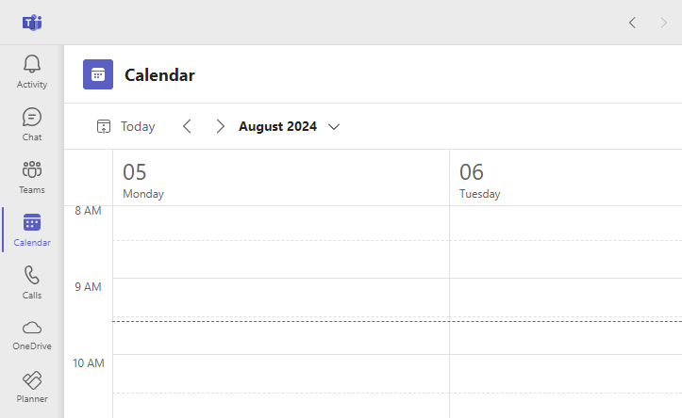
How to Open Your Calendar in Teams
To open your calendar in Teams, click “Calendar” on the left side menu of Teams, as seen in the image below. This calendar will mirror your Outlook calendar and functions similarly.

Slide 23
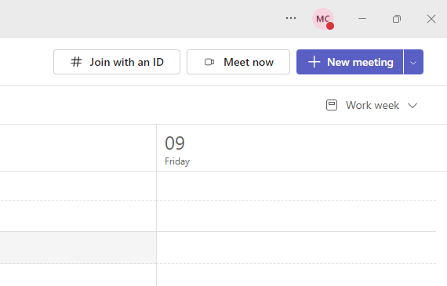
How to Schedule a Meeting in Teams Calendar
To schedule a meeting through Teams, click the purple “+ New meeting” button at the top right corner of your calendar, as seen in the image below. This button will open a pop-up window where you can schedule a new meeting.

Slide 24
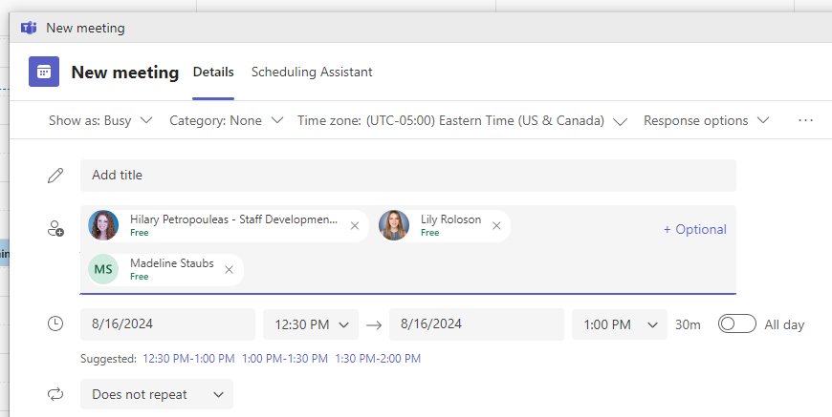
How to Schedule a Meeting in Teams Calendar (Cont.)
Once you add attendees to the event, you will have the same scheduling tools as in Outlook, except for the scheduling poll. You can use the Scheduling Assistant and/or the automatically generated meeting times, as seen in the image below. Please note that unlike Outlook, the scheduling tools in Teams do not take into account the availability of your meeting location, if in-person.

Slide 25
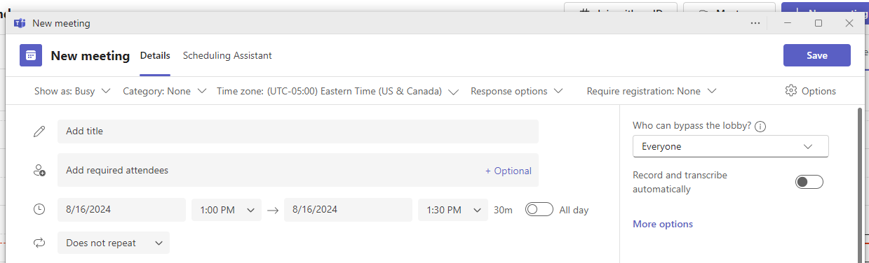
Notable Features When Scheduling a Meeting
Across the top ribbon of the new event window, you will find a variety of dropdown options to customize your meeting. The first notable option is the “Show as” dropdown, as seen in the image below. This dropdown will allow you to set your availability as free, tentative, busy, etc., just as you would for a meeting scheduled in Outlook.

Slide 26
Notable Features When Scheduling a Meeting (Cont.)
The “Category” dropdown allows you to color code your events and is the same as the “Categorize” feature in Outlook. If you are scheduling a meeting through Teams, you should use this dropdown to select the appropriate color for the meeting. Please note that any color categories you create in Outlook will be available in your Teams calendar as well.

Slide 27
Notable Features When Scheduling a Meeting (Cont.)
The “Response options” dropdown lets you customize whether you are requesting a response to meeting invitations and whether attendees can forward the meeting invite to others. The “Require registration” dropdown lets you record attendance for a meeting, which is helpful if you’re hosting a training session. However, this feature will soon be replaced by Webinar.

Slide 28
Notable Features When Scheduling a Meeting (Cont.)
On the right side of the new event window, there is the “Options” panel. This panel offers a variety of settings, including for security, audio and video, engagement, roles, and recording and transcribing. You can explore these settings by clicking “More options,” as seen in the image below. Although currently locked by IT, you will eventually have the ability to use Copilot to help you record and transcribe your virtual meetings!

Slide 29
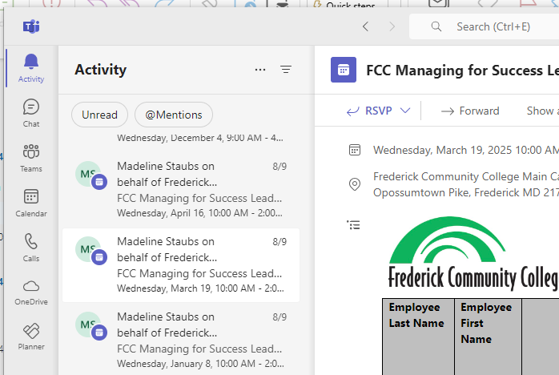
Accepting Meetings Through Teams Instead of Outlook
When you accept a meeting invitation in Outlook, the invitation email will automatically disappear. However, if you accept the meeting in Teams, the invitation email will not be deleted in Outlook. To accept a meeting invitation in Teams, follow these steps:
  Click “Activity” on the left side menu, as seen in the image to the right
  Open the meeting invitation in your activity feed
  Click “RSVP.” This will open a dropdown with RSVP options
  Click “Accept”

Slide 30
(3)
Teams Messaging & AI Features
This module will explore how WLR plans to standardize internal and external communications, along with new AI features for chat.

Slide 31
The Future of Teams Chat and Outlook Email
To help standardize how employees communicate, WLR will be moving to use Teams chat for internal messaging within the company and Outlook for external messaging outside of the company. Through this transition, your Outlook inbox will be streamlined, rather than being cluttered with both internal and external messages.
Additionally, communication about projects will be housed in the specific Teams feature of Microsoft Teams. We will explore this feature more in-depth next!

Slide 32
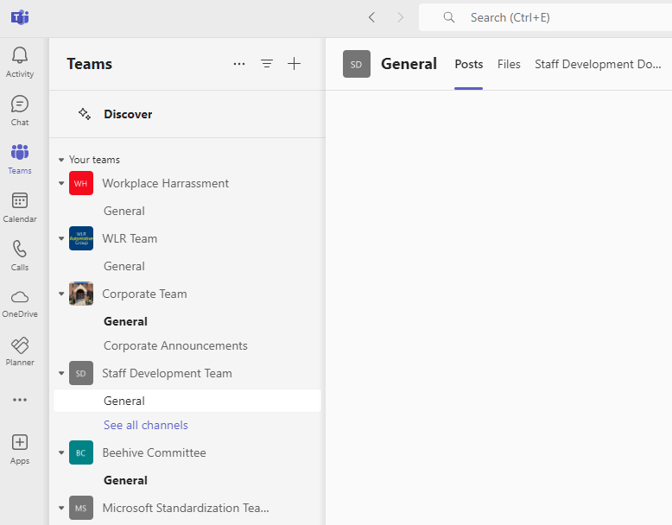
Standardizing Teams Communication for Projects
To familiarize yourself with the specific Teams feature, follow these steps:
  Click the “Teams” tab on the left side menu, as seen in the image to the right
  Click “General” for any teams you are a member of
  Under the “Posts” tab, write posts to message your team, share updates, seek feedback, and generate discussions

Slide 33
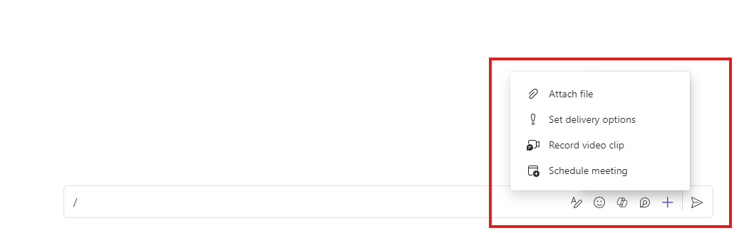
Review of AI Chat Messaging Features
If you have access to Copilot, you can now access this AI tool through your chat. Copilot will appear on a message draft next to the emoji icon, as seen in the image to the right. Copilot operates responsively as if you are having a conversation with it, and it can also summarize conversations you missed. The best way to interact with Copilot is to approach it like a person and ask if it can either perform a function for you or provide instructions.
Additionally, everyone has access to the “Attach file” feature where Teams will now offer file suggestions based on the content of the message.

Slide 34
(4)
Teams Mobile App Features
This final module of the course will explore helpful features in the Teams mobile app that can support you, whether you’re in the office or on the go.

Slide 35
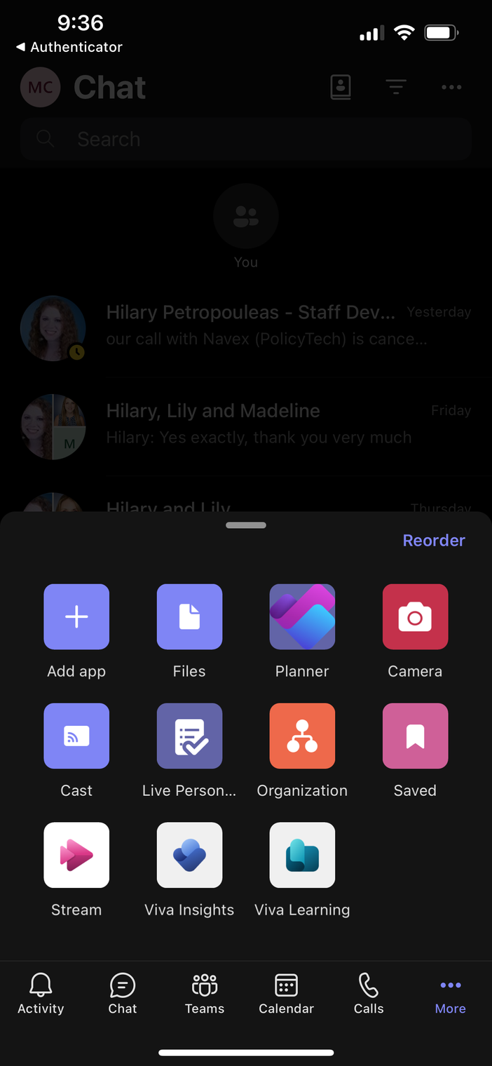
How to Open Planner in Your Teams Mobile App
To keep track of your tasks on a mobile device, follow these steps:
  Open the Teams mobile app
  At the bottom right corner, click “More,” as seen in the image to the right. This will open an options menu with more apps
  Click “Planner” to access your tasks and plans

Slide 36
How to Open Your Activity Feed & Silence Notifications
Your activity feed shows notifications for activity that you may have missed in your chat, such as reactions and mentions. To access your activity feed, review the Microsoft Support article Activity feed on the go.
If you would like to silence your notifications for a certain period of time, you can schedule quiet time. To set up quiet time for your Teams mobile app, review the Microsoft Support article Quiet time in Microsoft Teams for mobile devices.

Slide 37
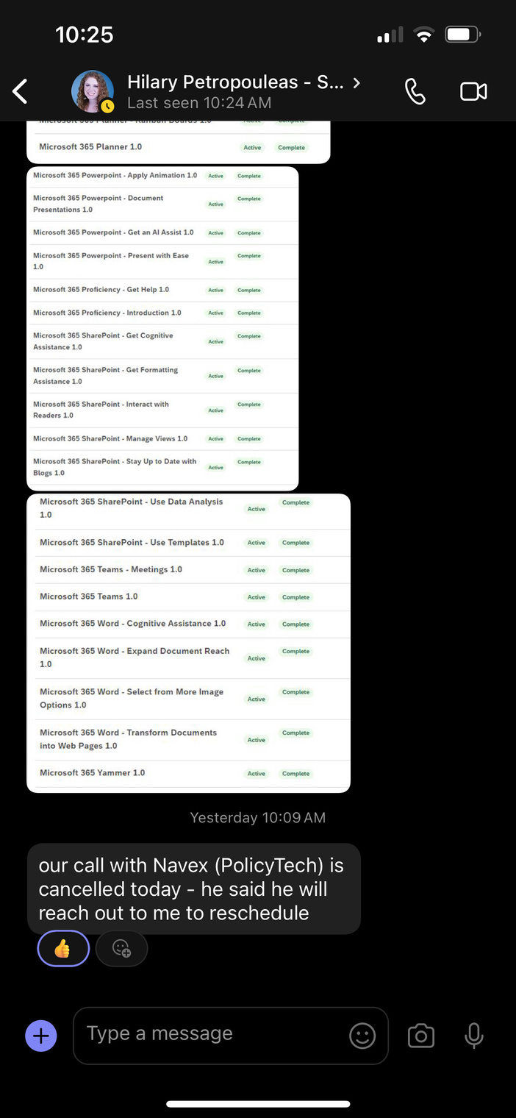
How to Create and Send Audio Messages
To create and share spoken audio messages through chat, follow these steps:
  Open the chat for who you want to send an audio message to
  Click and hold the microphone icon at the bottom right of the chat, as seen in the image to the right. You will need to press down on this icon for the entire time you are recording your audio message
  Once you have recorded your message, you will have the option to send it or delete it and re-record

Slide 38
How to Open and Use the Improved Camera
The camera for the Teams mobile app allows you to take photos and send them through chats. These photos can also be annotated directly in the app, and the camera is optimized for taking photos of white boards and documents. To use your camera, follow these steps:
  Click “More” on the bottom right corner of the app
  Click “Camera,” as seen in the image to the right. You will be able to take a photo and annotate it, such as with markers and written text
  Once you are done editing your photo, you will be prompted to select who you want to send the photo to

Slide 39
How to Connect Your Mobile Device and Desktop
The Teams app has a variety of features that can help your mobile device and desktop stay connected.
For example, transferring calls is helpful for when you are on a call at your desktop but need to move to a new location. To transfer a call from your desktop to a mobile device, and vice versa, review the Microsoft Support article Join a Microsoft Teams meeting on a second device.
You can also share your screen on a mobile device so that it casts to everyone in the meeting, no matter their device. To share your screen on a mobile device, review the Microsoft Support article Cast content from a mobile device to a Microsoft Teams Room.

