Slide 1

Microsoft 365 In-Person Training
(New Outlook)
Welcome! Thank you for your time today for the first in-person session of your Microsoft 365 Optimization Training.
Please find the assigned seat with your name. Then, log into the provided laptop with the instructions emailed to you prior to this session. If you have any issues logging in, please reach out to one of the Business Applications team members leading this session for assistance.

Slide 2
Training Agenda
  Pre-Survey
  Module 1
  Break
  Module 2
  Break
  Module 3
  Optional Q&A and One-on-One Support

Slide 3
Survey Instructions for Poll Everywhere
1. Open the Poll Everywhere link from the email that was sent to you prior to this session (PollEv.com/staffdevelopment624)
2. Click “Start survey”
3. Answer all the questions honestly and to the best of your ability. Remember that all answers are anonymous!
4. When you have answered all of the questions, click “Submit survey” at the bottom of the page

Slide 4
Module 1
Introduction to Planner & Customizing New Outlook
By the end of Module 1, you will be able to demonstrate how to:
  Open your calendar shortcut in Outlook
  Locate and add tasks to Planner through the calendar shortcut
  Change the due date of tasks through the calendar shortcut
  Customize your Outlook ribbon layout
  Customize your Outlook notifications
  Customize your shared calendar notifications

Slide 5
(Q1)
Where do you click to open the calendar shortcut?

Slide 6

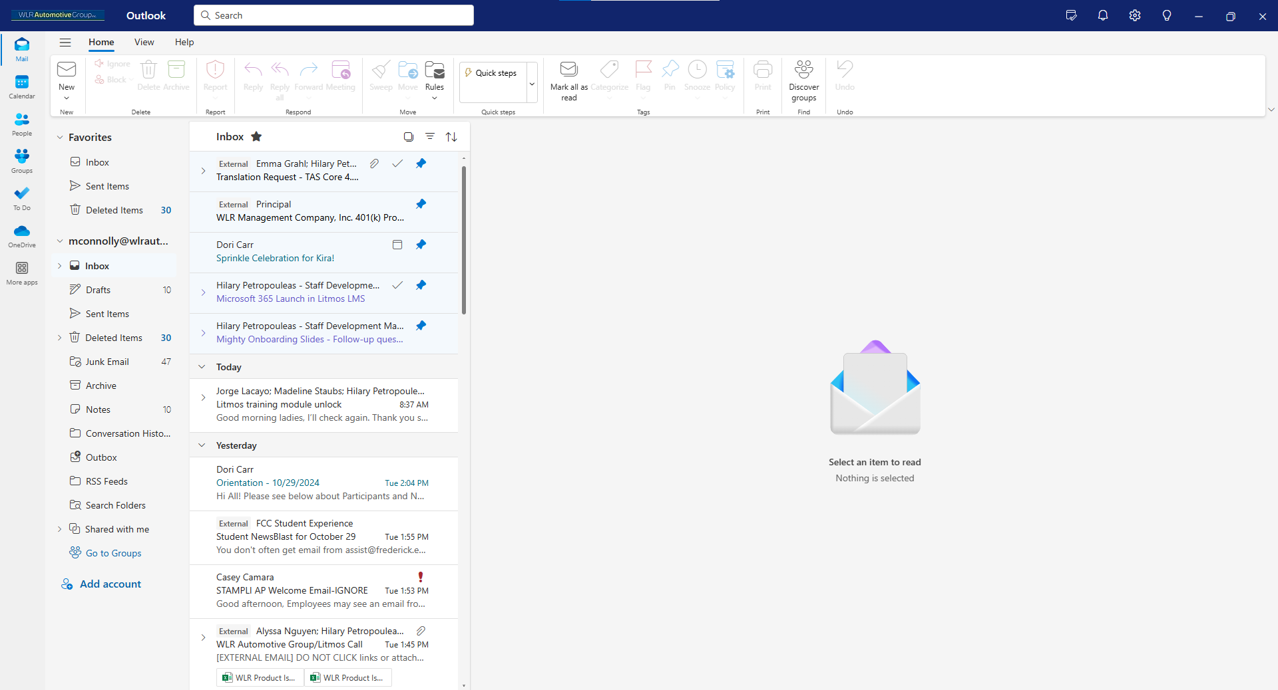

Slide 7
(Q2)
Click the area of the calendar shortcut that displays daily tasks.

Slide 8
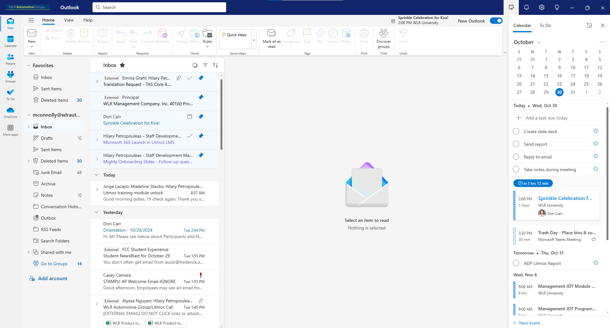

Slide 9
(Q3)
Where in the calendar shortcut do you click to add a new task?

Slide 11
(Q4)
After right clicking on a task in the calendar shortcut, where do you click on the options menu to change the due date of the task?

Slide 12
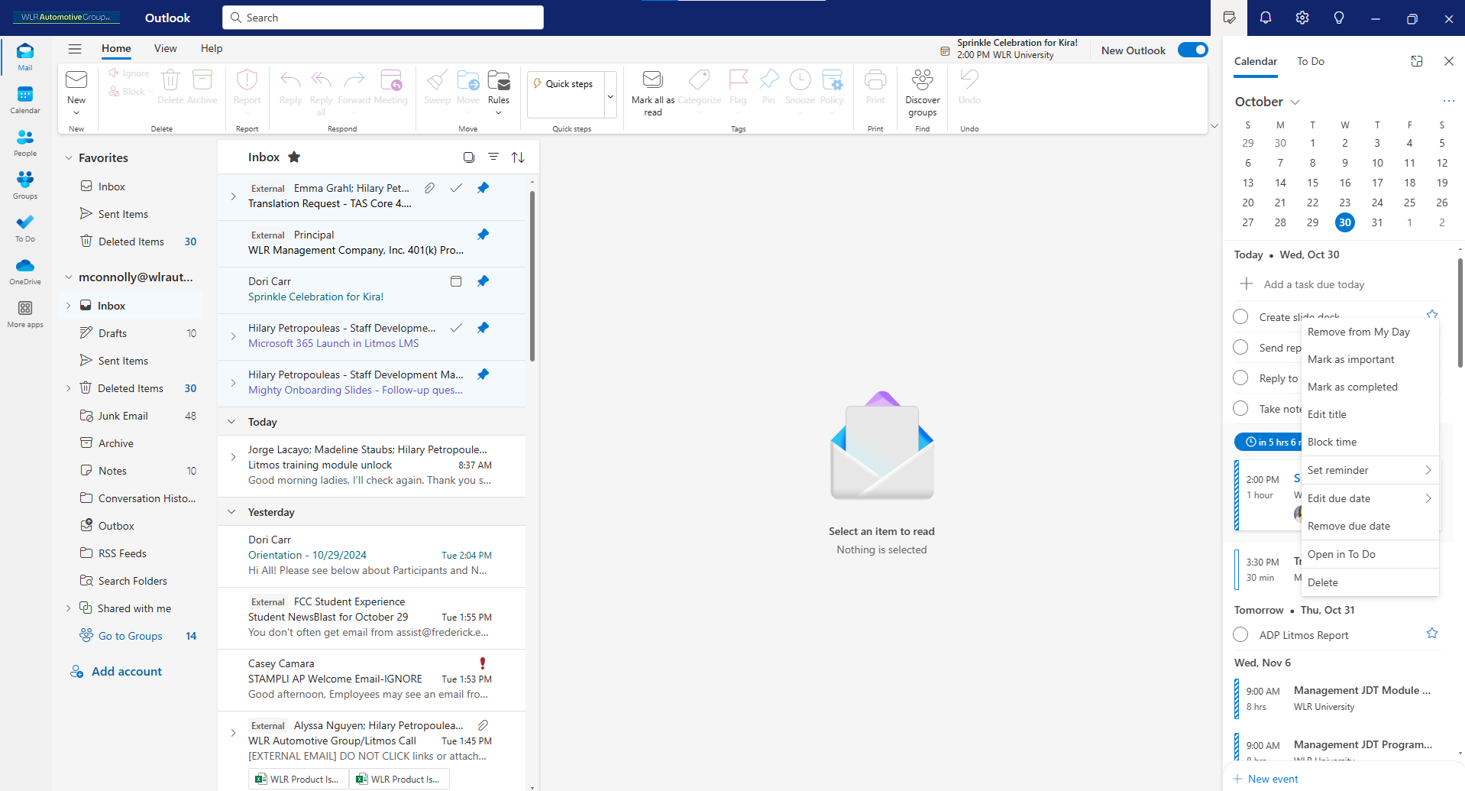

Slide 13
(Q5)
Where do you click to open Settings?

Slide 15
Break Time!
Please plan to be back 10 minutes after the start of our break.

Slide 16
Module 2
Standardizing Your Calendar & Scheduling Meetings
By the end of Module 2, you will be able to demonstrate how to:
  Effectively use time blocking for your calendar
  Properly color code calendar events
  Schedule both in-person and virtual meetings
  Schedule a meeting with automatic time suggestions
  Schedule a meeting with the scheduling poll
  Schedule a meeting with your Scheduling Assistant

Slide 17
(Q1)
After right clicking on an existing calendar event, where do you click on the options menu to time block?

Slide 18
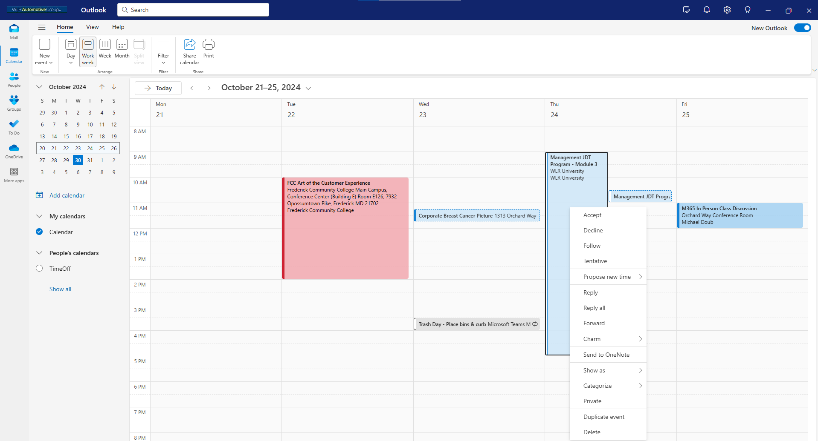

Slide 19
(Q2)
After right clicking on an existing calendar event, where do you click on the options menu to color code the event?

Slide 21
(Q3)
On a new event draft, where do you click to create an in-person meeting?

Slide 22
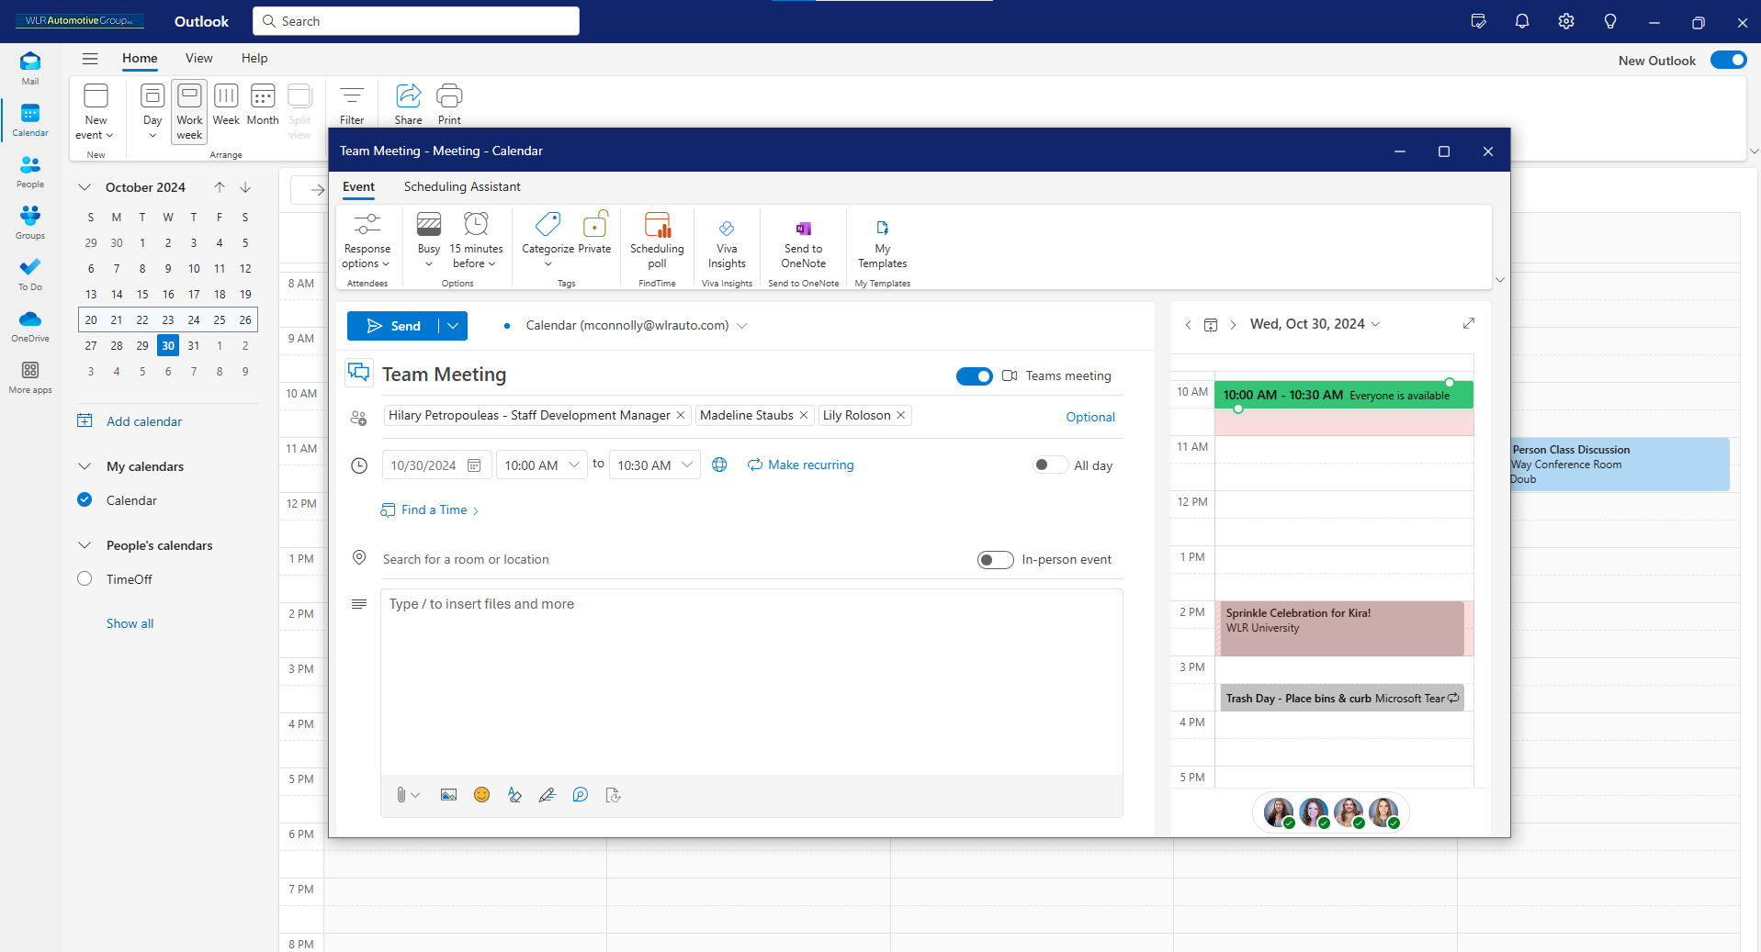

Slide 23
(Q4)
After adding attendees to a new event draft, where do you click to automatically generate meeting time suggestions?

Slide 25
(Q5)
On a new event draft, where do you click to open the scheduling poll?

Slide 27
(Q6)
On a new event draft, where do you click to open the Scheduling Assistant?

Slide 29
Break Time!
Please plan to be back 10 minutes after the start of our break.

Slide 30
Module 3
Optimizing Outlook Email & Inbox Automations
By the end of Module 3, you will be able to demonstrate how to:
  Use the commands tab when writing an email
  Schedule emails to be sent at a later time
  Recall emails after you have sent them
  Automate your inbox with quick steps
  Automate your inbox with rules
  Automate your inbox with sweep
  Automate your inbox with conditional formatting

Slide 31
(Q1)
In a new email draft, where do you click to schedule an email?

Slide 32
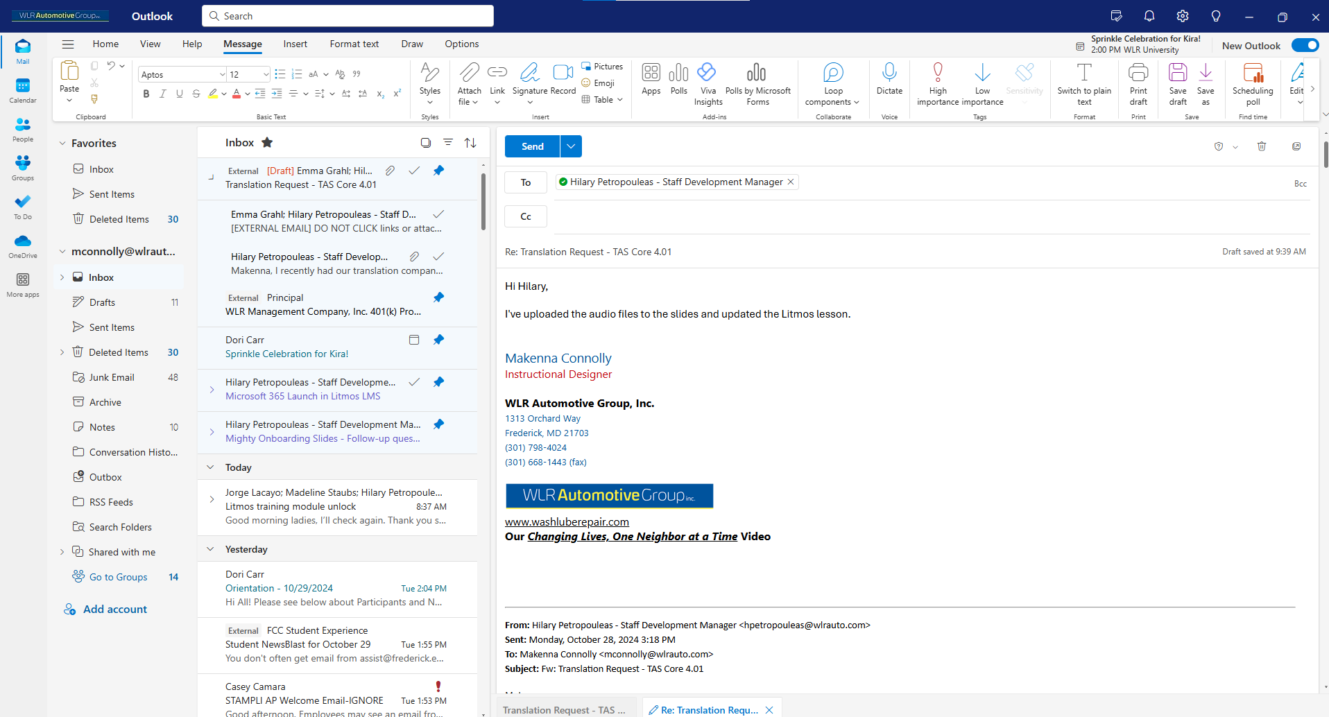

Slide 33
(Q2)
In a sent email, and after clicking the three dots at the top right corner of the email, where do you click on the options menu to recall an email?

Slide 34
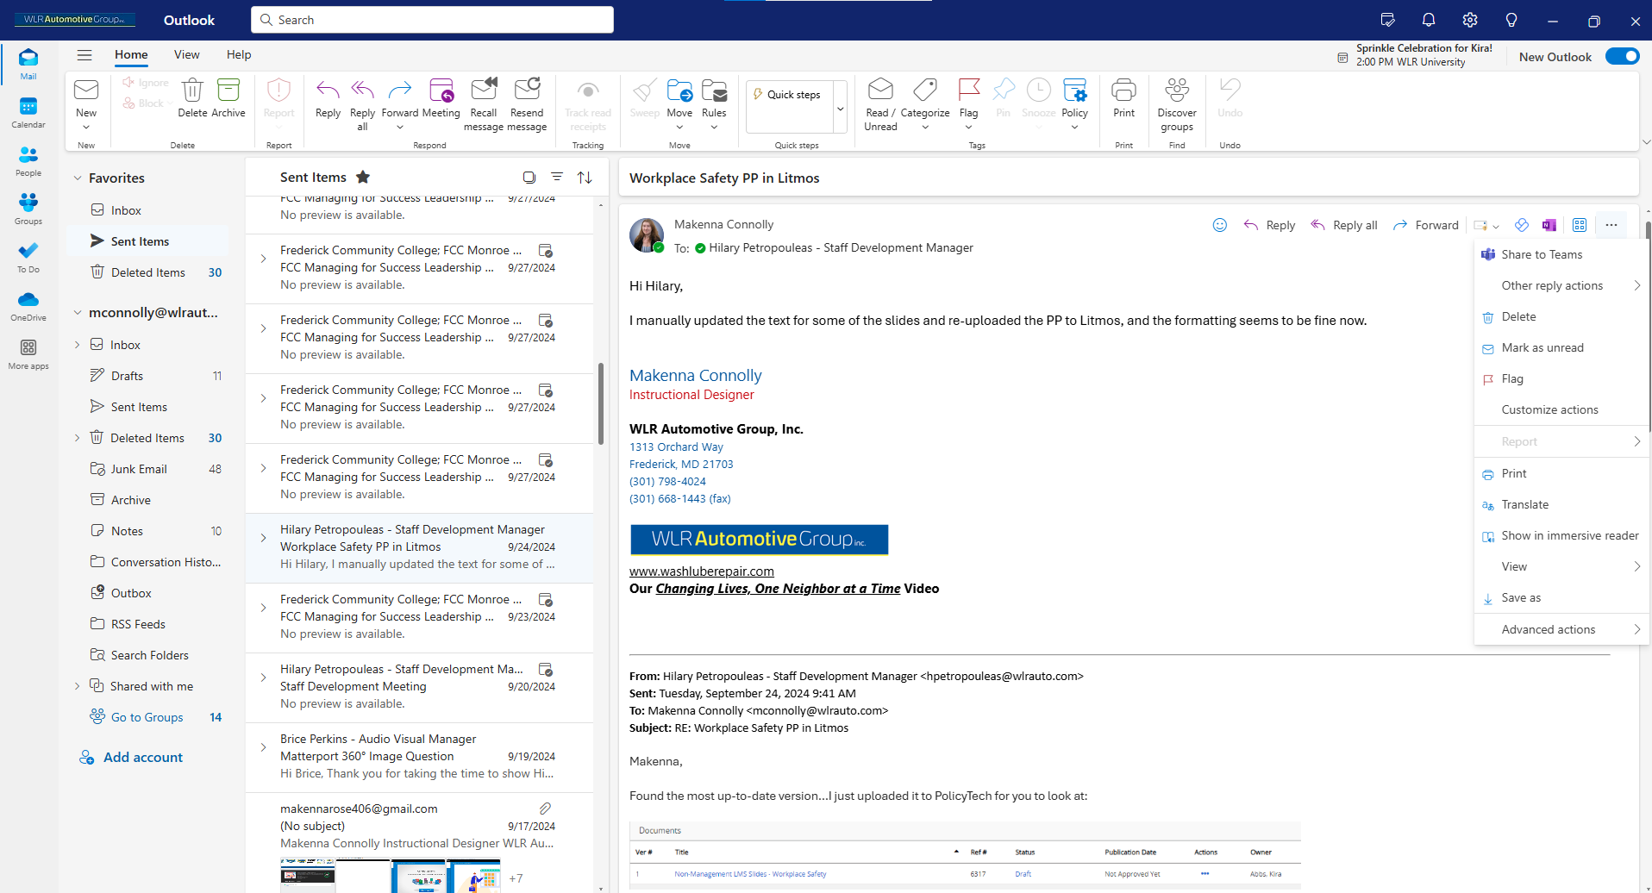

Slide 35
(Q3)
After opening Settings, where do click to access quick steps, rules, and conditional formatting?

Slide 36
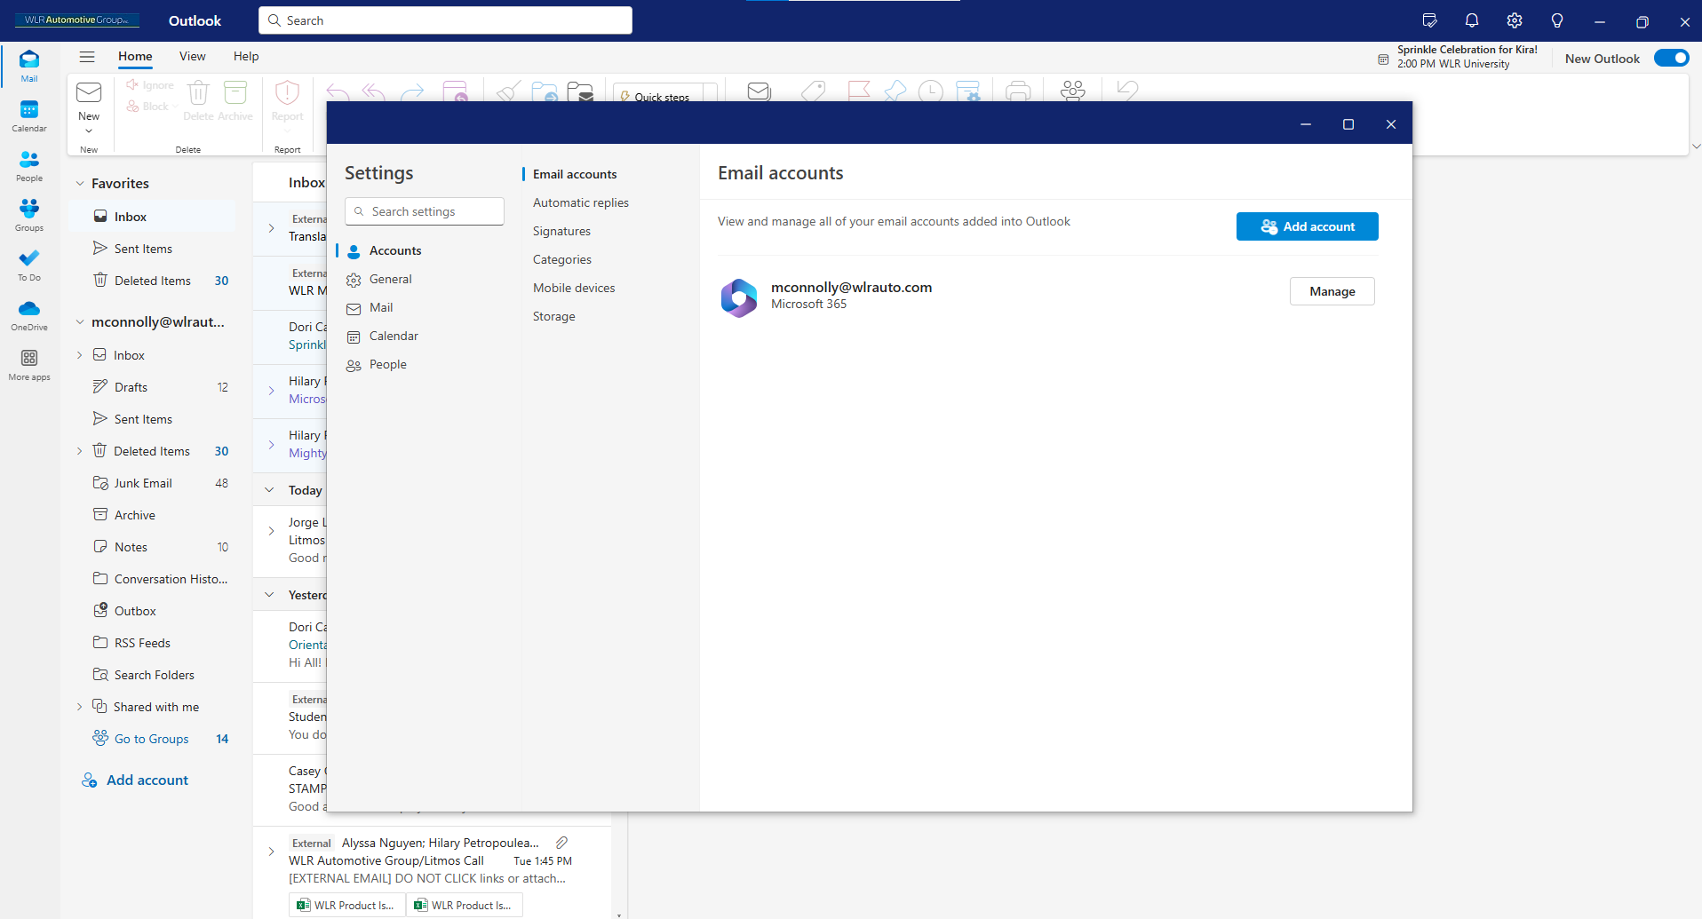

Slide 37
(Q4)
After clicking on an email in your inbox, where do you click to perform a sweep?

Slide 38
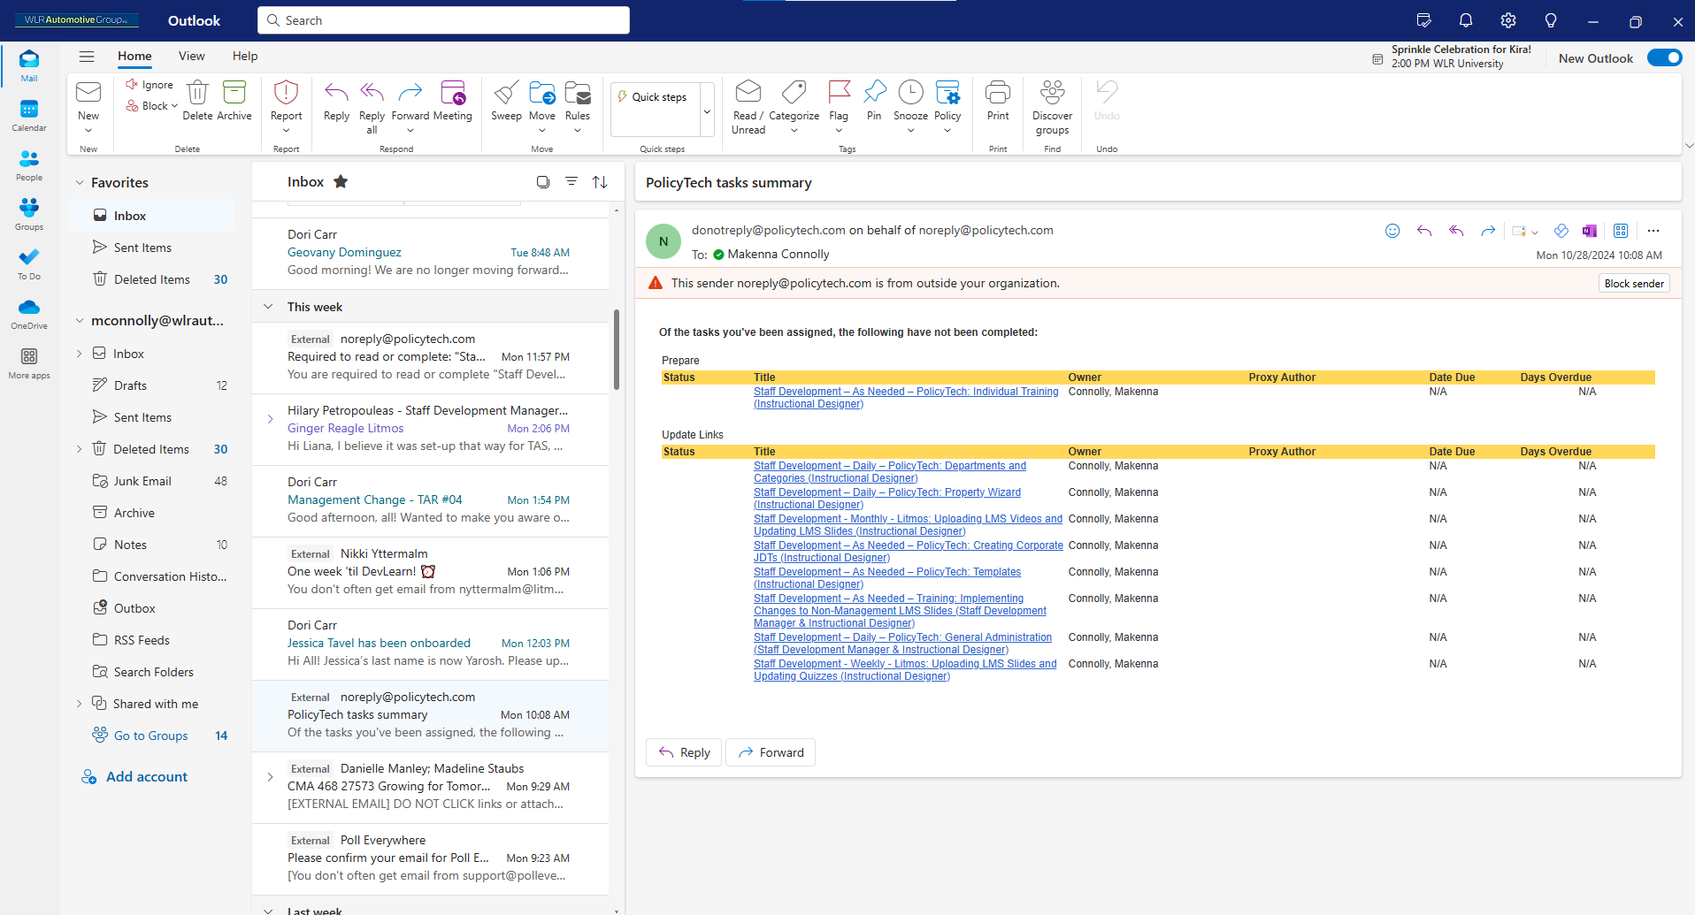

Slide 39
Optional Q&A and One-on-One Support
Opportunity for Questions and Extra Help
Thank you for your hard work and engagement! Whether you stay or leave, please remember to:
  Complete your practice activities in the Litmos course before your next training session
  Complete the post-training survey that will be emailed to you tomorrow
  Check the date of your next and final training session
  Reach out to the Business Applications team with any follow-up questions

